Slide 1
Lecture 1: Introduction to Regression

Slide 2
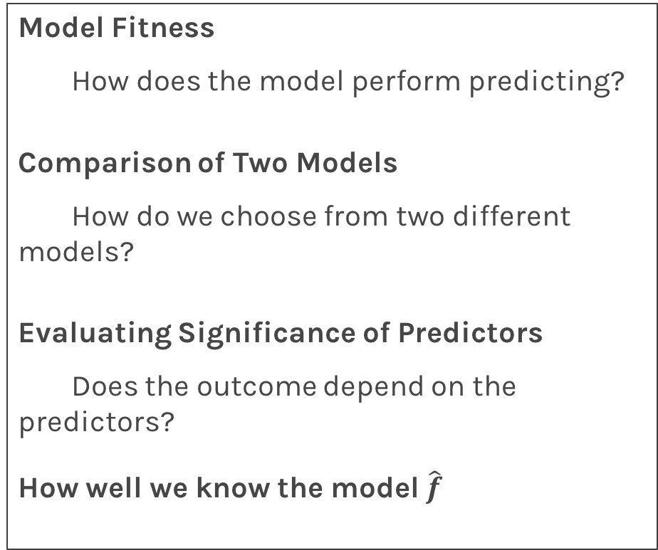
Lecture Outline
Logistics
Program Structure
Data
Statistical Modeling I
k-Nearest Neighbors (kNN)
Statistical Modeling II
Linear Regression
Model Fitness
How does the model perform predicting?
Comparison of Two Models
How do we choose from two different models?
Evaluating Significance of Predictors
Does the outcome depend on the predictors?
How well we know the model $\hat{f}$

Slide 3
Class Logistics

Slide 4
What
Lectures: Eight lectures
Day 1: Regression: Linear and kNN
Day 2: Classification: Logistic and kNN
Day 3: Decision trees: Bagging, Random Forest and Boosting
Day 4: Deep Neural Networks: Feed Forward, CNN
Labs: Eight Labs. Labs will provide practical examples to help you understand the material.
Project: Select from one of the provided projects and work in a group.

Slide 5
Who
Valérie Gauthier, Universidad del Rosario, Mathematician from Universidad de los Andes, Bogota, Colombia. She obtained her PhD in applied mathematics, in the area of post-quantum cryptography from Danmarks Tekniske Universitet (DTU). She is the head of the Applied Mathematics and Computer Science Department at Universidad del Rosario, Bogotá, Colombia.

Slide 6
Who
Julián Rincón, Universidad del Rosario. He has a Ph.D. in computational physics, modeling and algorithms design from Instituto Balseiro Centro Atómico de Bariloche, Argentina. His is an Assistant Professor at Universidad del Rosario, Colombia, Department of Applied Mathematics and Computer Science.
.

Slide 7
Who
Juan F. Perez, Assistant Professor in AM and CS at Universidad del Rosario. He obtained a PhD in Computer Science from the University of Antwerp, Belgium. He was a Research Associate in performance analysis at Imperial College and the University of Melbourne, Australia. His interests center around the performance analysis of computer systems, especially on software applications, cloud and cluster computing, and optical networking.

Slide 8
Who
Dora Suárez, Universidad del Rosario. She is a Teaching and Research Fellow at Universidad del Rosario, Colombia. She obtained a Bachelor degree in Statistics from Universidad Nacional, Colombia, and the Master's degree in Statistics from the Federal University of Pernambuco, Brazil. Her current interests are in the areas of data analysis, programming, and graphical design.
.

Slide 9
Who
Luis Felipe Giraldo, Universidad de los Andes. Luis received his PhD. degree in Electrical and Computer Engineering at The Ohio State University, USA, in 2016. His current research interests include design and analysis of interconnected dynamical systems, large-scale processing of signals, and humanitarian engineering.
.

Slide 10
Who
Germán Obando, Universidad del Rosario. Germán received his Ph.D. degree from Ecole des Mines de Nantes, France and U. de los Andes in 2016. He was a postdoctoral Fellow with the Research Group in Control and Automation Systems at Universidad de los Andes. He is currently an Assistant Professor in AM and CS. His current research interests include distributed optimization, population dynamics, and game theory.
.

Slide 11
Who
Rafael Martinez Galarza: Harvard-Smithsonian Center for Astrophysics , PhD Leiden 2012. His research focuses on star formation and time-domain astronomy. He is a member of the LSST Transients and Variable Stars collaborations, where he has been doing preparatory work for the LSST survey, including ML classification.

Slide 12

Who
Pavlos Protopapas, Scientific Director of the Institute for Applied Computational Science (IACS). Teaches Data Science1 and Data Science 2 at Harvard. His research is in astrostatistics and he is excited about the new telescopes coming online in the next few years.

Slide 13
How - Schedule
Time | Activity
Lecture 1 | 9.00-10.30
Break | 10.30-11.00
Lab 1 | 11.00-12.00
Exercises 1 | 12.00-13.00
Lunch | 13.00-14.00
Lecture 2 | 14.00-15.30
Break | 15.30-16.00
Lab 2 | 16.00-17.00
Exercises 2 | 17.00-18.00

Slide 14
Data Science

Slide 15

Why?

Slide 16
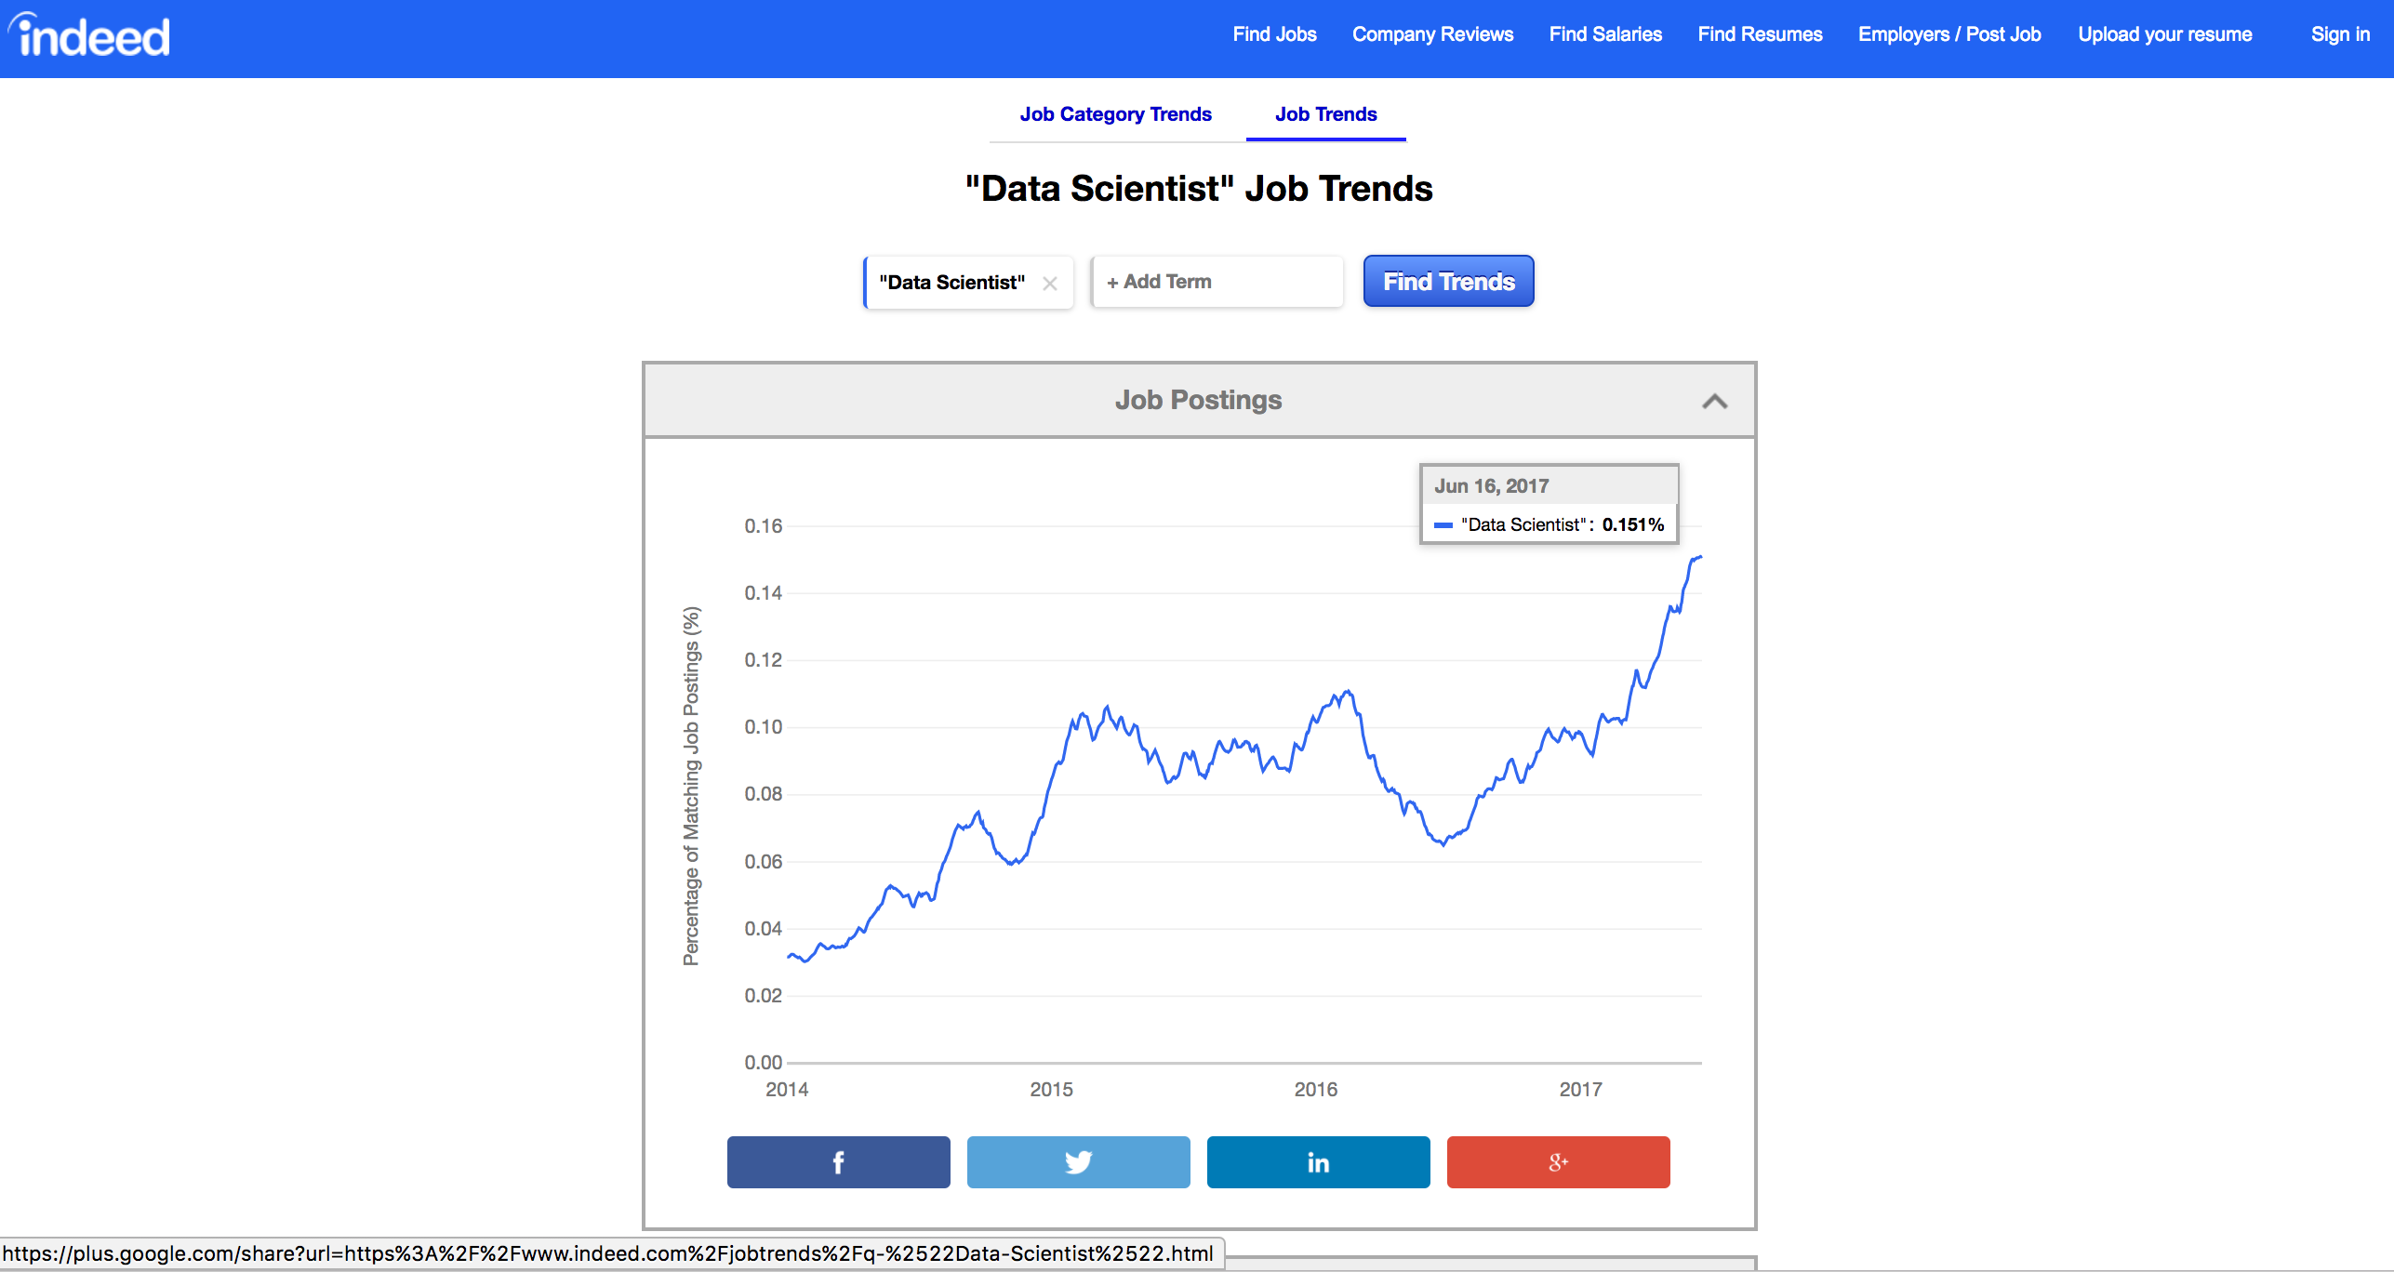
Why?

Slide 17
Why?

Slide 18
Data Science Process

Slide 19
Let’s start

Slide 20
Predicting a Variable
Let's image a scenario where we'd like to predict one variable using another (or a set of other) variables.
Examples:
Predicting the amount of view a YouTube video will get next week based on video length, the date it was posted, previous number of views, etc.
Predicting which movies a Netflix user will rate highly based on their previous movie ratings, demographic data etc.

Slide 21
Data

Slide 22
Data
The Advertising data set consists of the sales of that product in 200 different markets, along with advertising budgets for the product in each of those markets for three different media: TV, radio, and newspaper. Everything is given in units of $1000.
,
TV | radio | newspaper | sales
230.1 | 37.8 | 69.2 | 22.1
44.5 | 39.3 | 45.1 | 10.4
17.2 | 45.9 | 69.3 | 9.3
151.5 | 41.3 | 58.5 | 18.5
180.8 | 10.8 | 58.4 | 12.9
Some of the figures in this presentation are taken from "An Introduction to Statistical Learning, with applications in R" (Springer, 2013) with permission from the authors: G. James, D. Witten, T. Hastie and R. Tibshirani "
Notes:
Supposed we were asked by a client to provide advice on how to improve sales of a particular product.
Does that footnote belong on this slide?

Slide 23
Response vs. Predictor Variables
There is an asymmetry in many of these problems:
The variable we'd like to predict may be more difficult to measure, is more important than the other(s), or may be directly or indirectly influenced by the values of the other variable(s).
Thus, we'd like to define two categories of variables:
variables whose value we want to predict
variables whose values we use to make our prediction.
Notes:
Give an example

Slide 24
Response vs. Predictor Variables
X
predictors
features
covariates
Y
outcome
response variable
dependent variable
TV | radio | newspaper | sales
230.1 | 37.8 | 69.2 | 22.1
44.5 | 39.3 | 45.1 | 10.4
17.2 | 45.9 | 69.3 | 9.3
151.5 | 41.3 | 58.5 | 18.5
180.8 | 10.8 | 58.4 | 12.9
n observations
p predictors

Slide 25
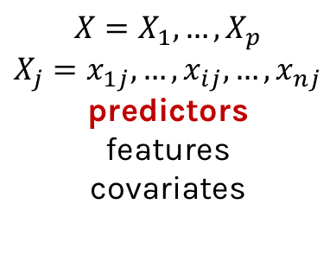
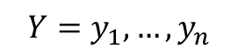
Response vs. Predictor Variables
$$X=X_{1},…,X_{p}$$
$$X_{j}=x_{1j},…,x_{ij},…,x_{nj}$$
predictors
features
covariates
outcome
response variable
dependent variable
$$Y=y_{1},…,y_{n}$$
TV | radio | newspaper | sales
230.1 | 37.8 | 69.2 | 22.1
44.5 | 39.3 | 45.1 | 10.4
17.2 | 45.9 | 69.3 | 9.3
151.5 | 41.3 | 58.5 | 18.5
180.8 | 10.8 | 58.4 | 12.9
n observations
p predictors
Notes:
I changed y_p to y_n. I think this makes the dimensions correct now. (DLS)

Slide 26
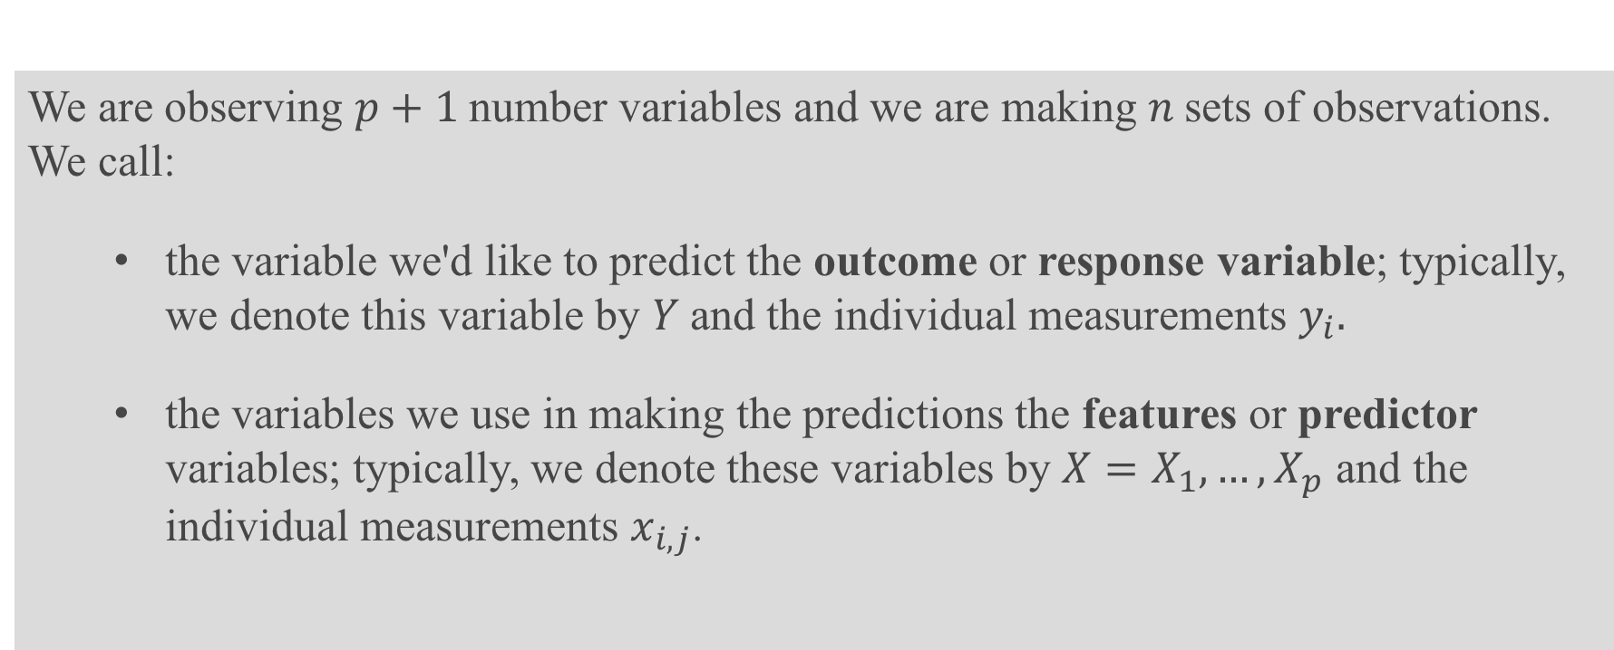
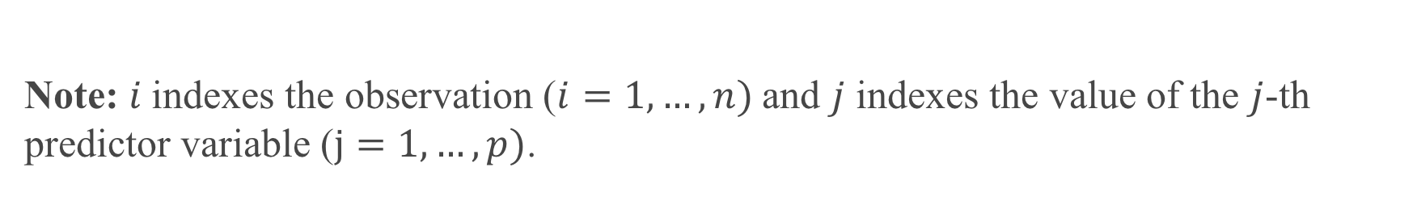
Definition
We are observing $p+1$number variables and we are making $n$sets of observations. We call:
the variable we'd like to predict the outcome or response variable; typically, we denote this variable by $Y$and the individual measurements $y_{i}.$
the variables we use in making the predictions the features or predictor variables; typically, we denote these variables by $X=X_{1},…,X_{p}$ and the individual measurements $x_{i,j}$.
Note: $i$indexes the observation ($i=1,…,n)$and $j$ indexes the value of the $j$-th predictor variable ($j=1,…,p)$.

Slide 27
Statistical Model

Slide 28
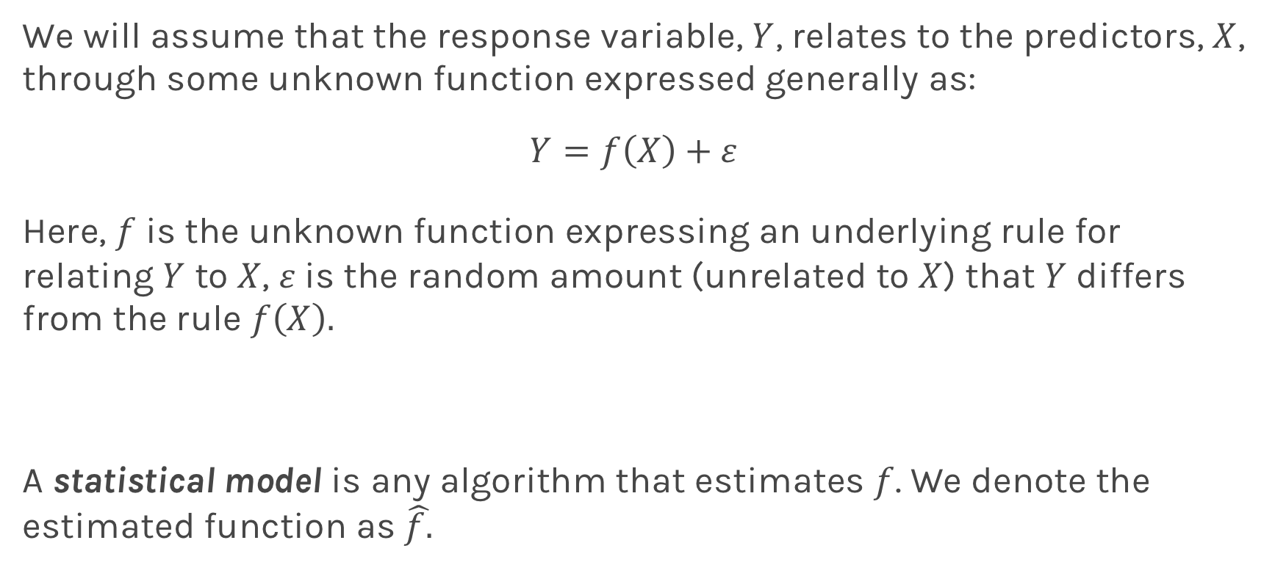
True vs. Statistical Model
We will assume that the response variable, $Y$, relates to the predictors, $X$, through some unknown function expressed generally as:
$$Y=f\left(X\right)+ε$$
Here, $f$ is the unknown function expressing an underlying rule for relating $Y$ to $X$, $ε$is the random amount (unrelated to $X$) that $Y$ differs from the rule $f\left(X\right).$
A statistical model is any algorithm that estimates $f$. We denote the estimated function as $\hat{f.}$
Notes:
Change x and y to uppercase? (DLS)

Slide 29
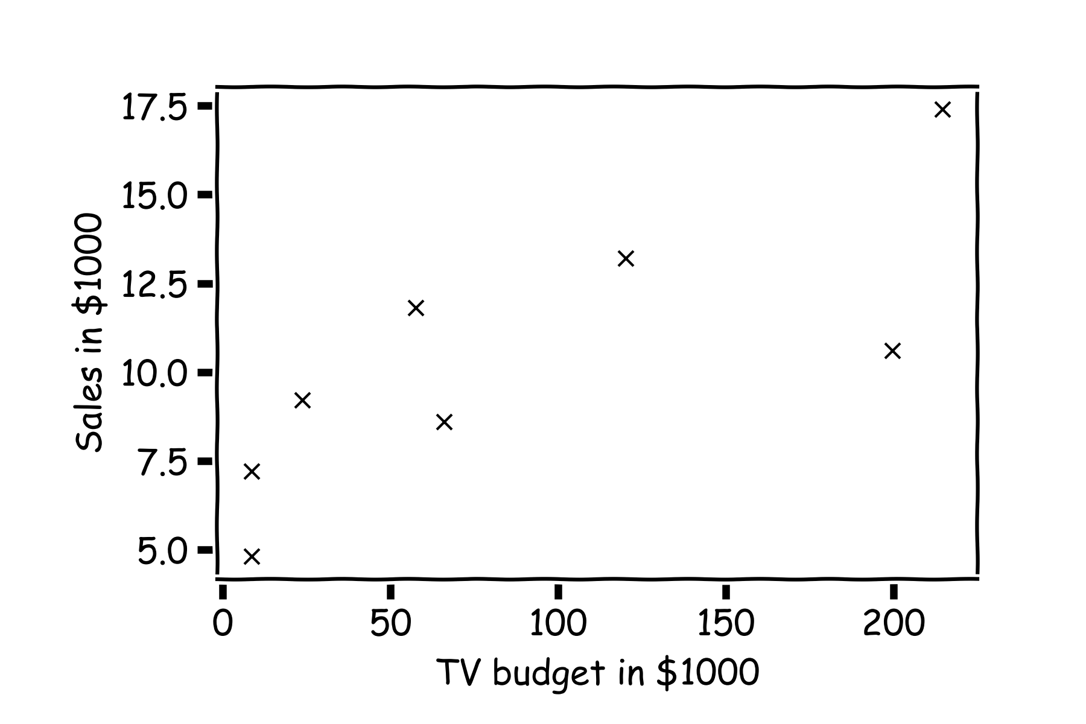
Statistical Model
y
x

Slide 30
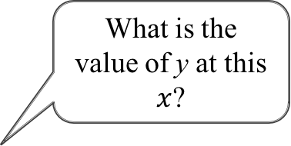
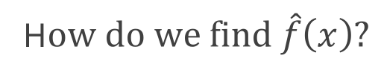
Statistical Model
H$ow do we find \hat{f}\left(x\right)?$
What is the value of y at this $x$?

Slide 31
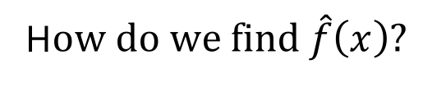
Statistical Model
H$ow do we find \hat{f}\left(x\right)?$
or here?

Slide 32
Statistical Model
Simple idea is to take the mean of all y’s, $\hat{f}\left(x\right)=\frac{1}{n}\sum_{1}^{n}{y_{i}}$

Slide 33
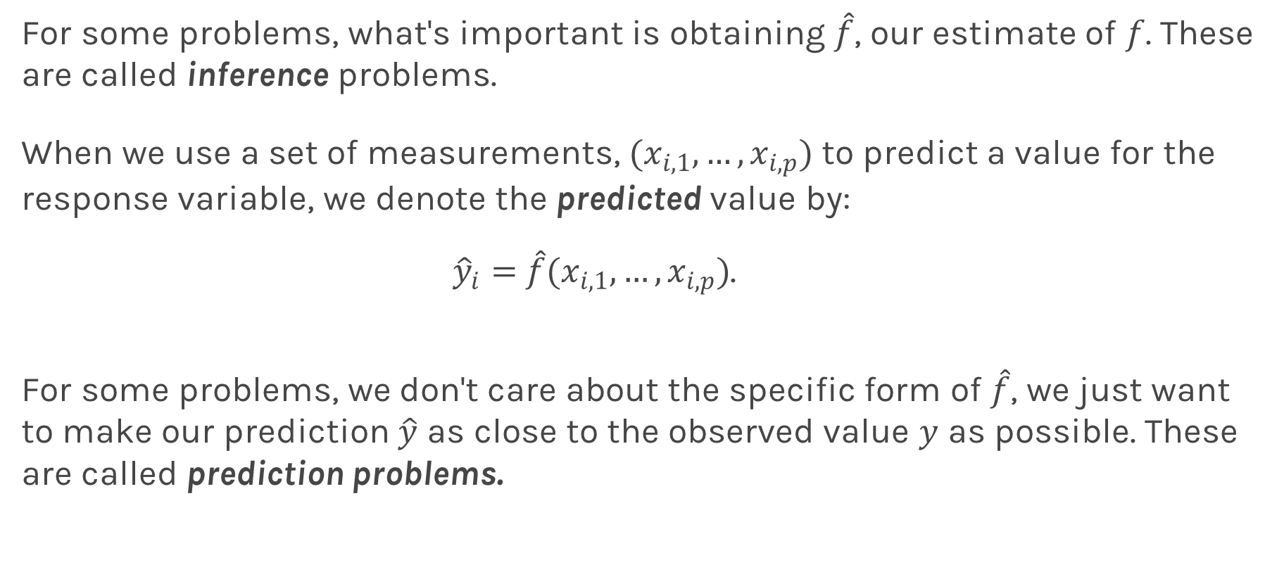
Prediction vs. Inference
For some problems, what's important is obtaining $\hat{f}$, our estimate of $f$. These are called inference problems.
When we use a set of measurements, $(x_{i,1}, …,x_{i,p})$ to predict a value for the response variable, we denote the predicted value by:
${\hat{y}}_{i}=$ $\hat{f}(x_{i,1}, …,x_{i,p})$.
For some problems, we don't care about the specific form of $\hat{f}$, we just want to make our prediction $\hat{y}$ as close to the observed value $y$ as possible. These are called prediction problems.

Slide 34
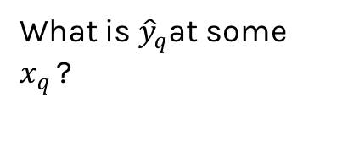
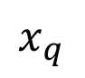
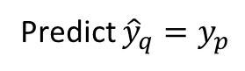
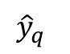
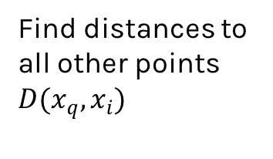
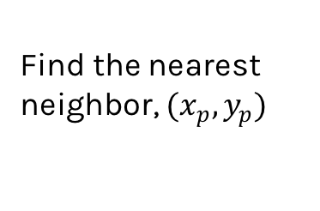
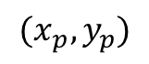
Simple Prediction Model
What is ${\hat{y}}_{q}$at some $x_{q }$?
Find distances to all other points $D(x_{q},x_{i})$
$${(x}_{p},y_{p})$$
$${\hat{y}}_{q}$$
Find the nearest neighbor, ${(x}_{p},y_{p})$
Predict ${\hat{y}}_{q}=y_{p}$
$$x_{q}$$

Slide 35
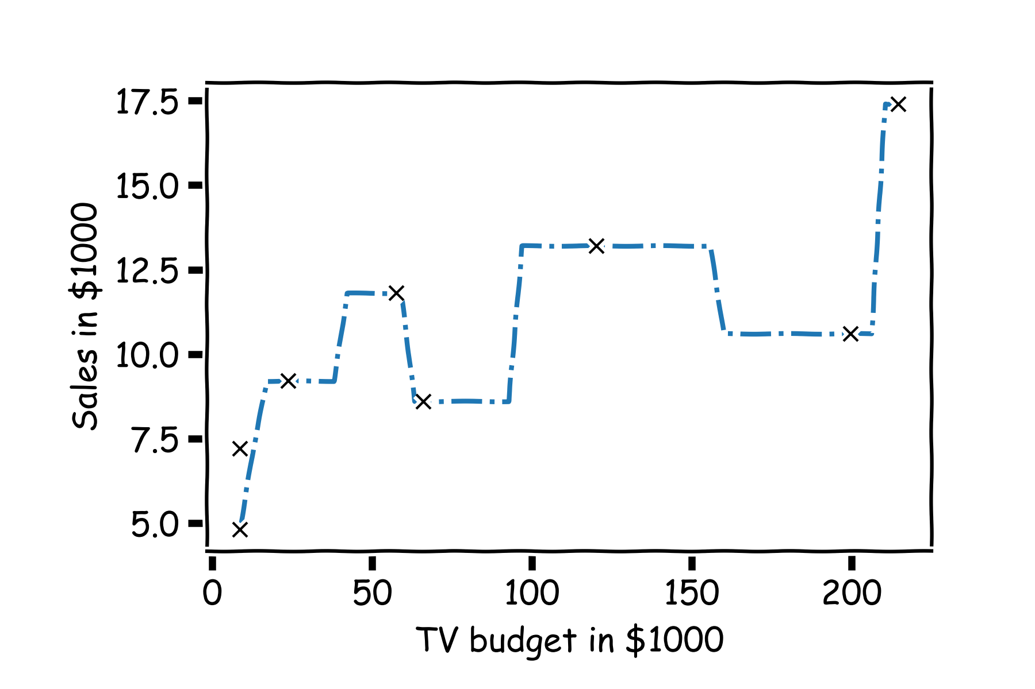
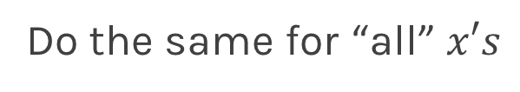
Simple Prediction Model
Do the same for “all” $x′s$

Slide 36
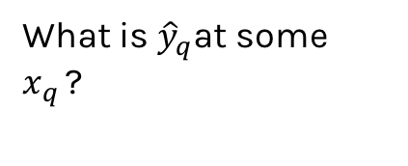
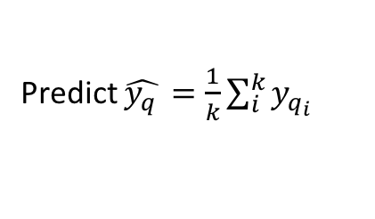
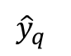
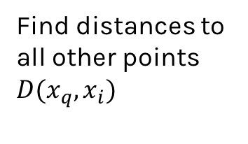
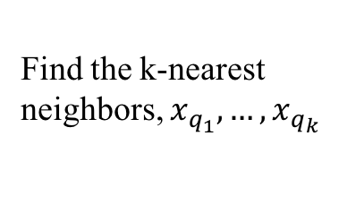
Extend the Prediction Model
What is ${\hat{y}}_{q}$at some $x_{q }$?
Find distances to all other points $D(x_{q},x_{i})$
$${\hat{y}}_{q}$$
Find the k-nearest neighbors, $x_{q_{1}},…,x_{q_{k}}$
Predict $\hat{y_{q }}=\frac{1}{k}\sum_{i}^{k}{y_{q_{i}}}$
$$x_{q}$$
Notes:
Change indeces and show k-nearest

Slide 37
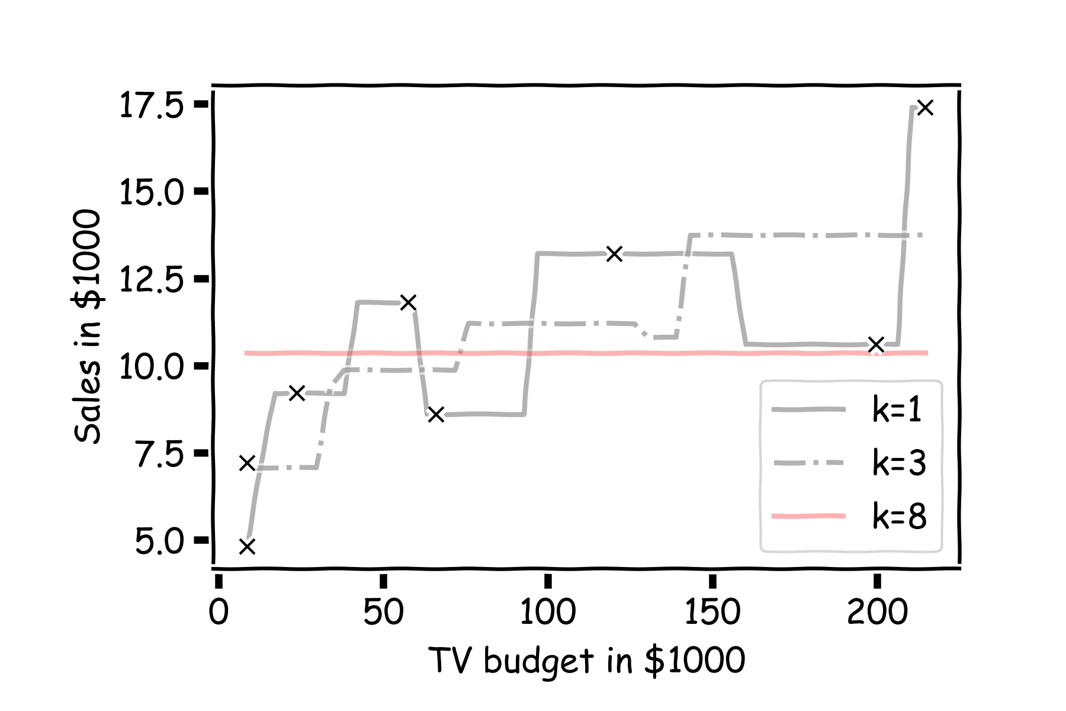
Simple Prediction Models
Notes:
Change indeces and show k-nearest

Slide 38

Simple Prediction Models
Same models on more data
Notes:
Change indeces and show k-nearest

Slide 39
k-Nearest Neighbors
The k-Nearest Neighbor (kNN) model is an intuitive way to predict a quantitative response variable:
to predict a response for a set of observed predictor values, we use the responses of other observations most similar to it
Note: this strategy can also be applied in classification to predict a categorical variable. We will encounter kNN again later in the course in the context of classification.
Notes:
Change indeces and show k-nearest

Slide 40
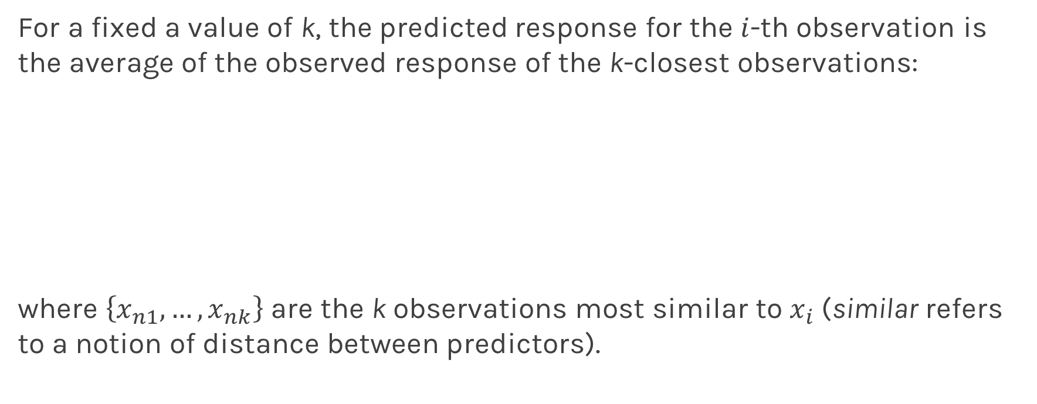
k-Nearest Neighbors - kNN
For a fixed a value of k, the predicted response for the $i$-th observation is the average of the observed response of the k-closest observations:
where $\left\{x_{n1},…,x_{nk}\right\}$ are the k observations most similar to $x_{i}$ (similar refers to a notion of distance between predictors).
Notes:
Notice y_hat instead of f_hat
I think the index on y_hat is wrong but I can’t change it b/c it’s an image. (DLS)

Slide 41
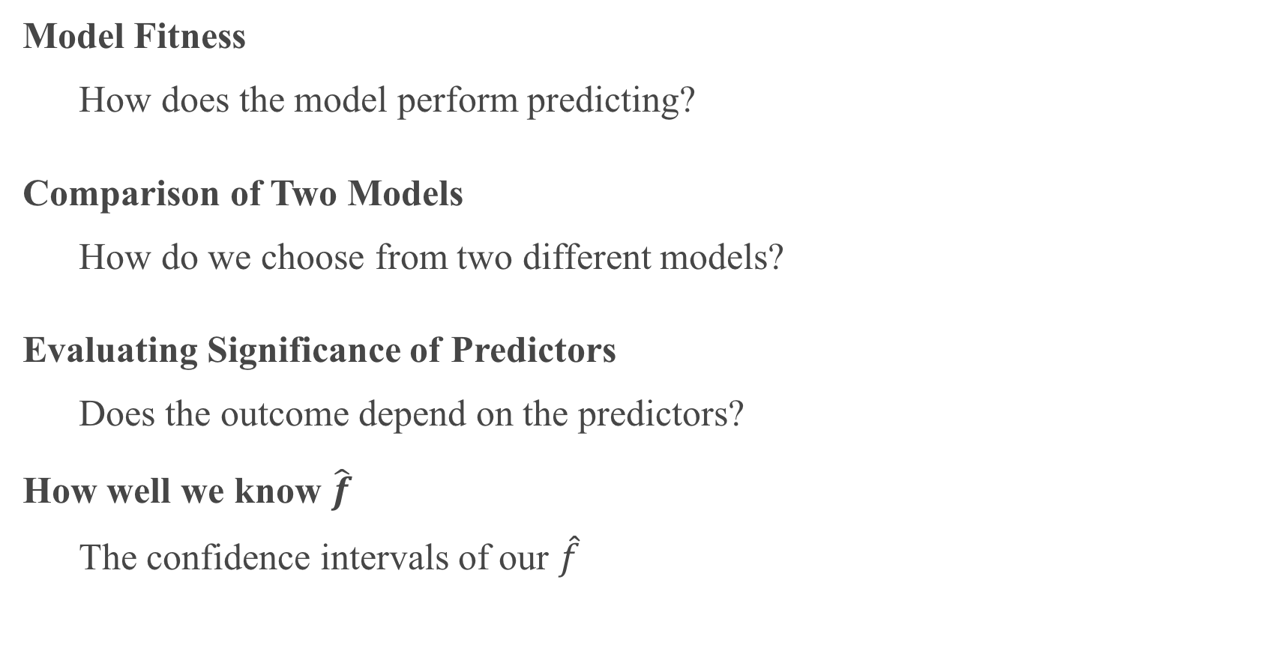
Things to Consider
Model Fitness
How does the model perform predicting?
Comparison of Two Models
How do we choose from two different models?
Evaluating Significance of Predictors
Does the outcome depend on the predictors?
How well we know $\hat{f}$
The confidence intervals of our $\hat{f}$

Slide 42
Error Evaluation

Slide 43
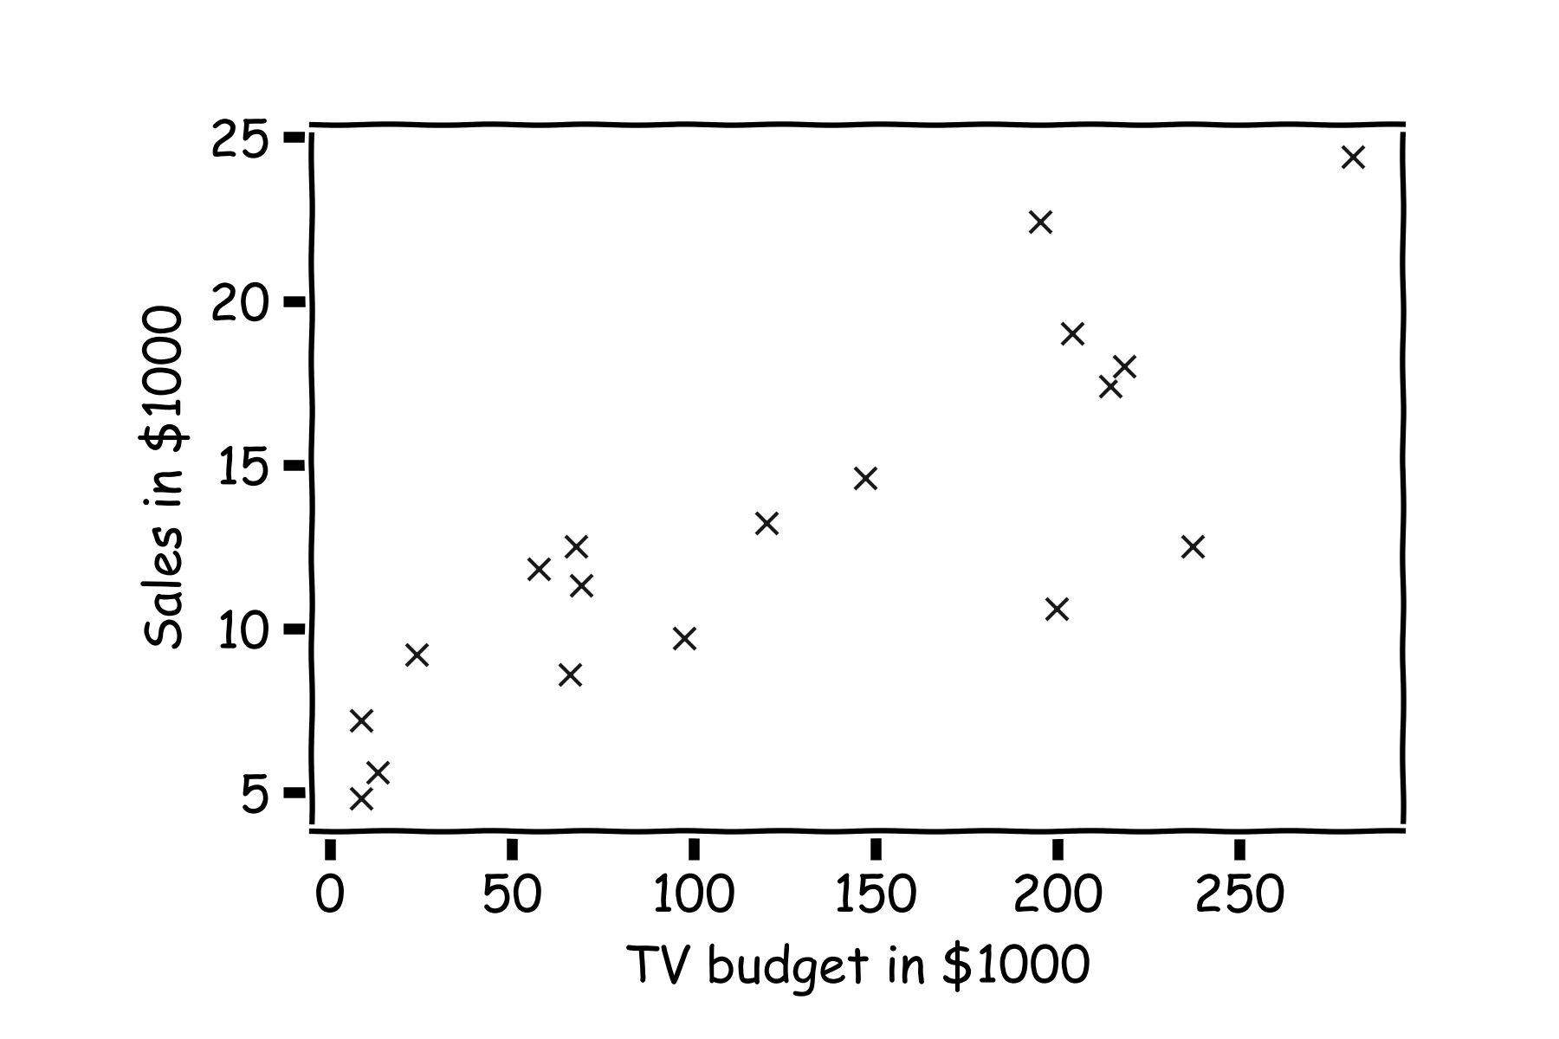
Error Evaluation
Start with some data.
Notes:
Change indeces and show k-nearest

Slide 44
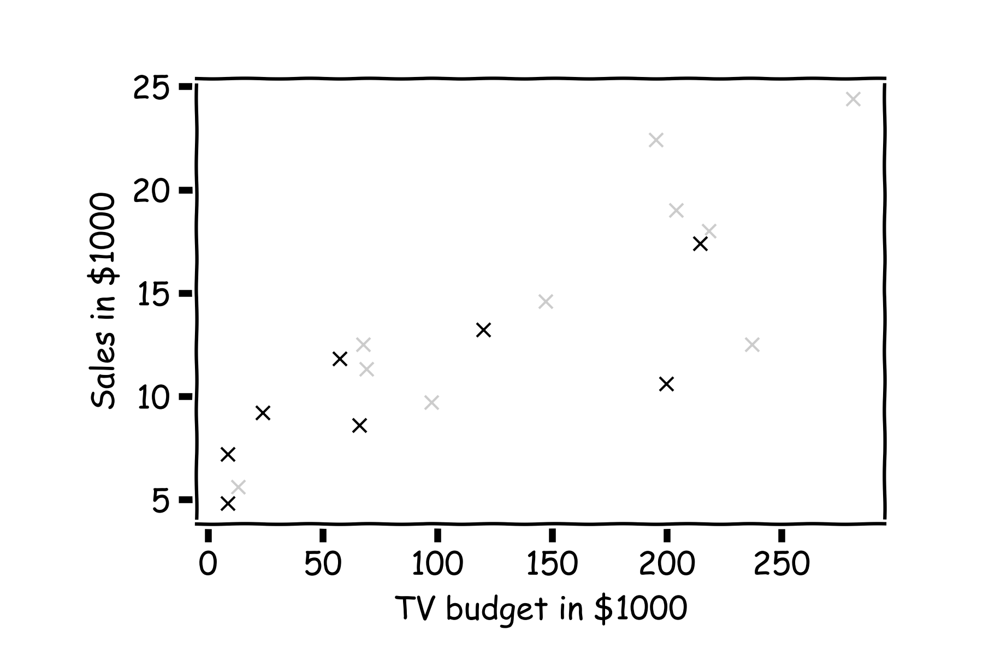
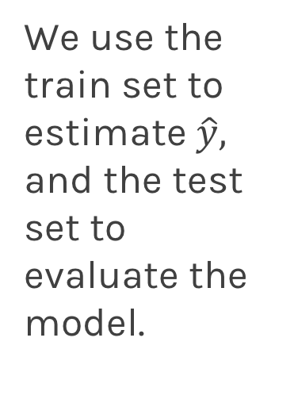
Error Evaluation
Hide some of the data from the model. This is called train-test split.
We use the train set to estimate $\hat{y},$ and the test set to evaluate the model.

Slide 45
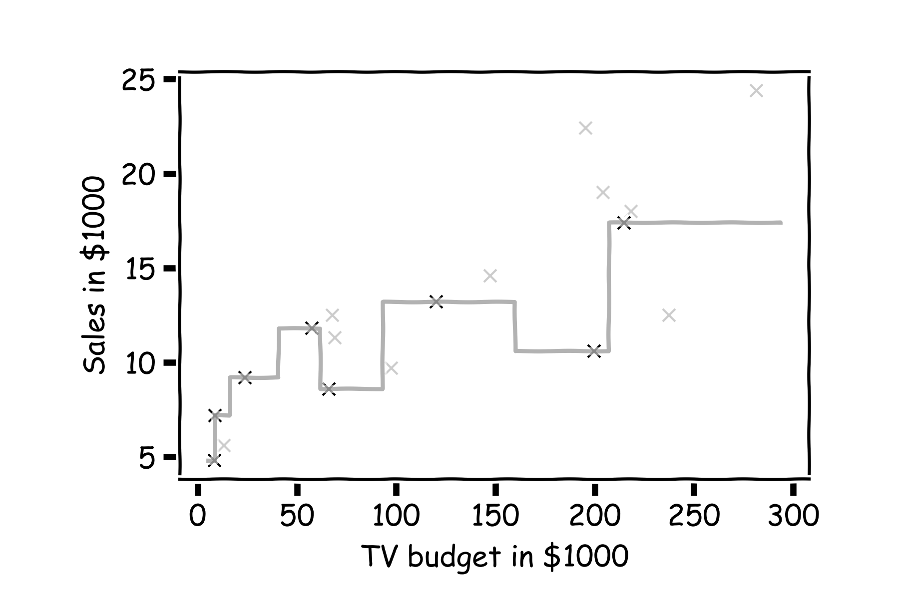
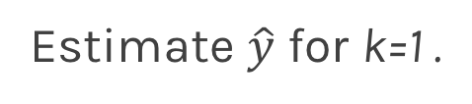
Error Evaluation
Estimate $\hat{y}$ for k=1 .
Notes:
Change indeces and show k-nearest

Slide 46
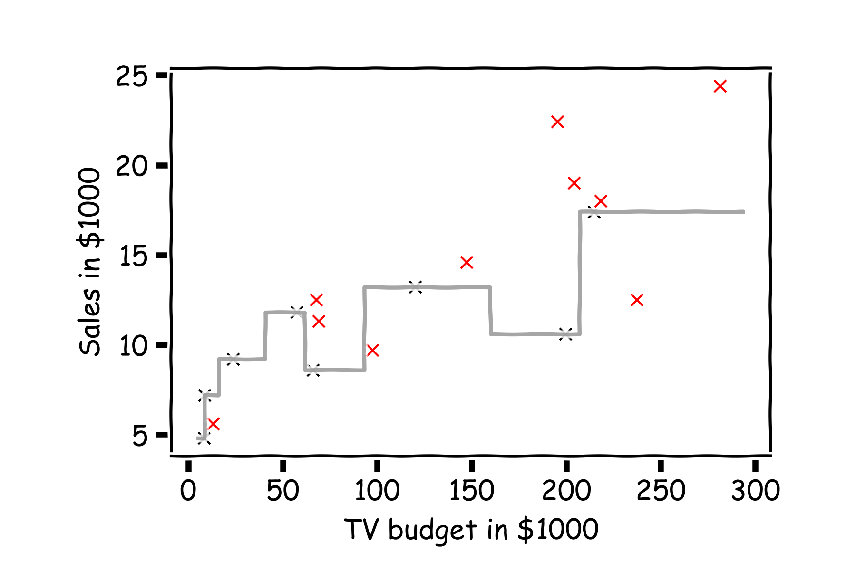
Error Evaluation
Now, we look at the data we have not used, the test data (red crosses).

Slide 47
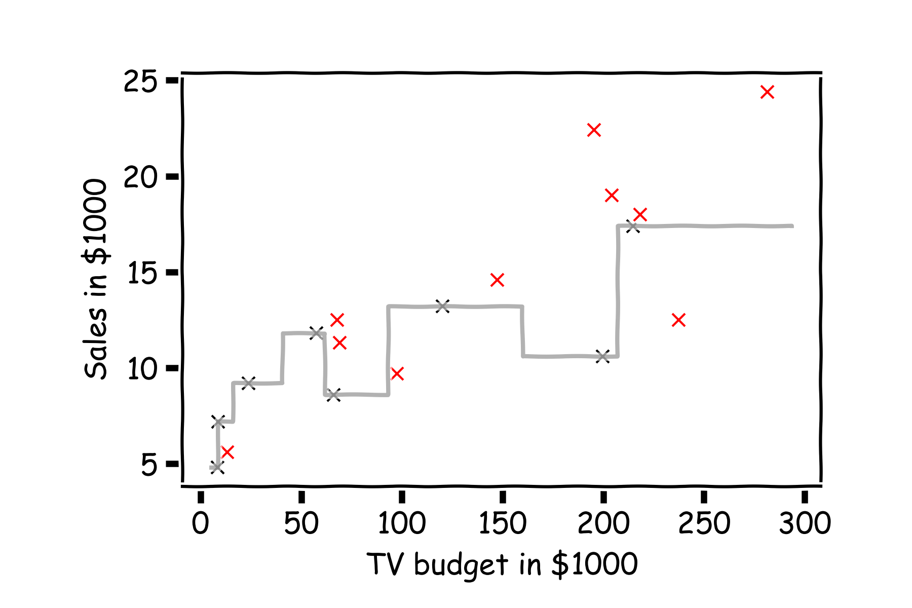
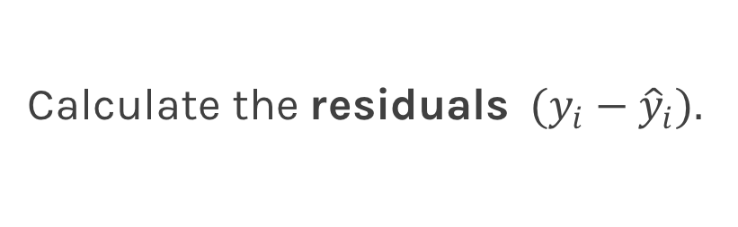
Error Evaluation
Calculate the ${\text{residuals} (y}_{i}−{\hat{y}}_{i}).$
Notes:
Change indeces and show k-nearest

Slide 48
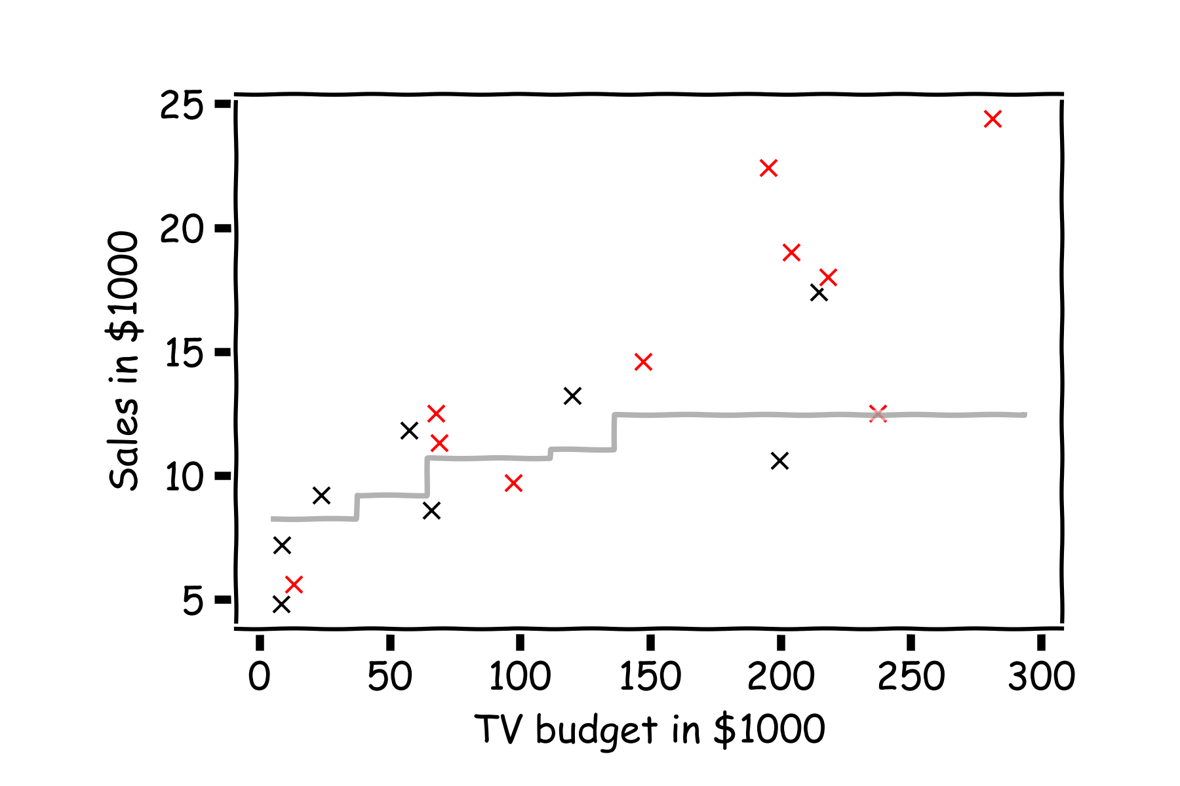
Error Evaluation
Do the same for k=3.
Notes:
Change indeces and show k-nearest

Slide 49
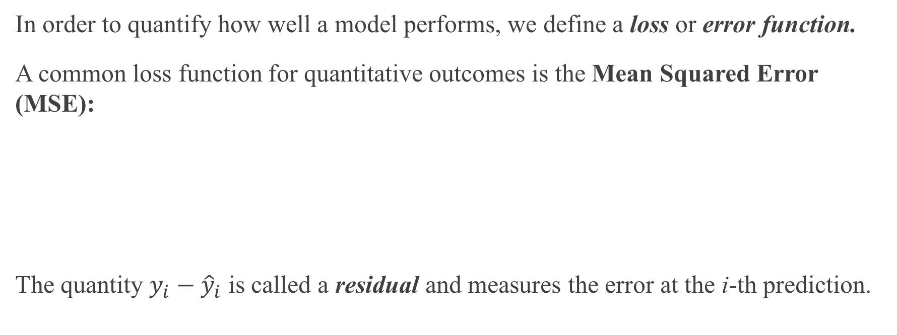
Error Evaluation
In order to quantify how well a model performs, we define a loss or error function.
A common loss function for quantitative outcomes is the Mean Squared Error (MSE):
The quantity $y_{i}−{\hat{y}}_{i}$ is called a residual and measures the error at the i-th prediction.
Notes:
Change indeces and show k-nearest

Slide 50
Error Evaluation
Caution: The MSE is by no means the only valid (or the best) loss function!
Question: What would be an intuitive loss function for predicting categorical outcomes?
Note: The square Root of the Mean of the Squared Errors (RMSE) is also commonly used.
Notes:
Change indeces and show k-nearest
Do you want to mention that RMSE isn’t always great b/c it’s not smooth? This would give them an idea on the things to consider when choosing loss functions. (DLS)

Slide 51
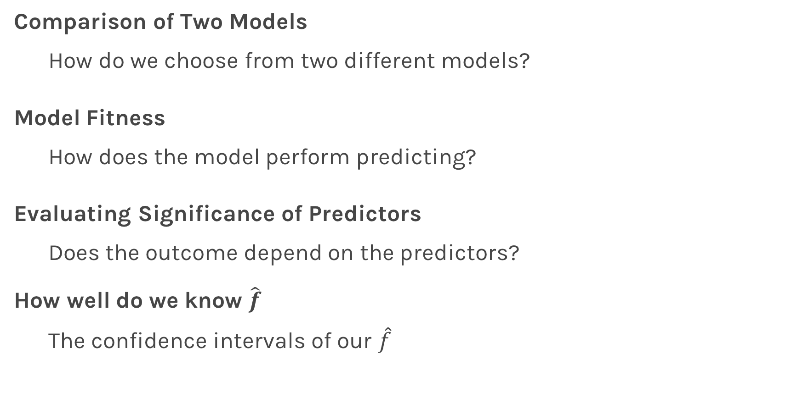
Things to Consider
Comparison of Two Models
How do we choose from two different models?
Model Fitness
How does the model perform predicting?
Evaluating Significance of Predictors
Does the outcome depend on the predictors?
How well do we know $\hat{f}$
The confidence intervals of our $\hat{f}$

Slide 52
Model Comparison

Slide 53
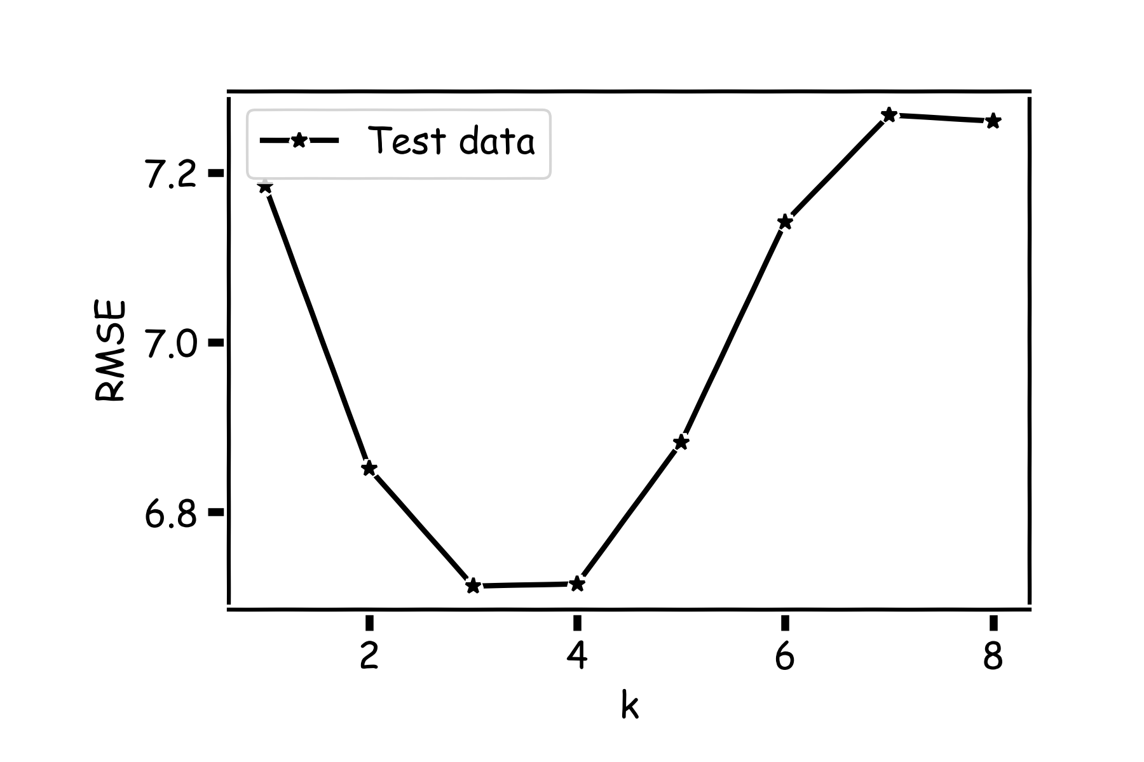
Model Comparison
Do the same for all k’s and compare the RMSEs. k=3 seems to be the best model.

Slide 54
Things to Consider
Comparison of Two Models
How do we choose from two different models?
Model Fitness
How does the model perform predicting?
Evaluating Significance of Predictors
Does the outcome depend on the predictors?
How well do we know $\hat{f}$
The confidence intervals of our $\hat{f}$

Slide 55
Model Fitness

Slide 56
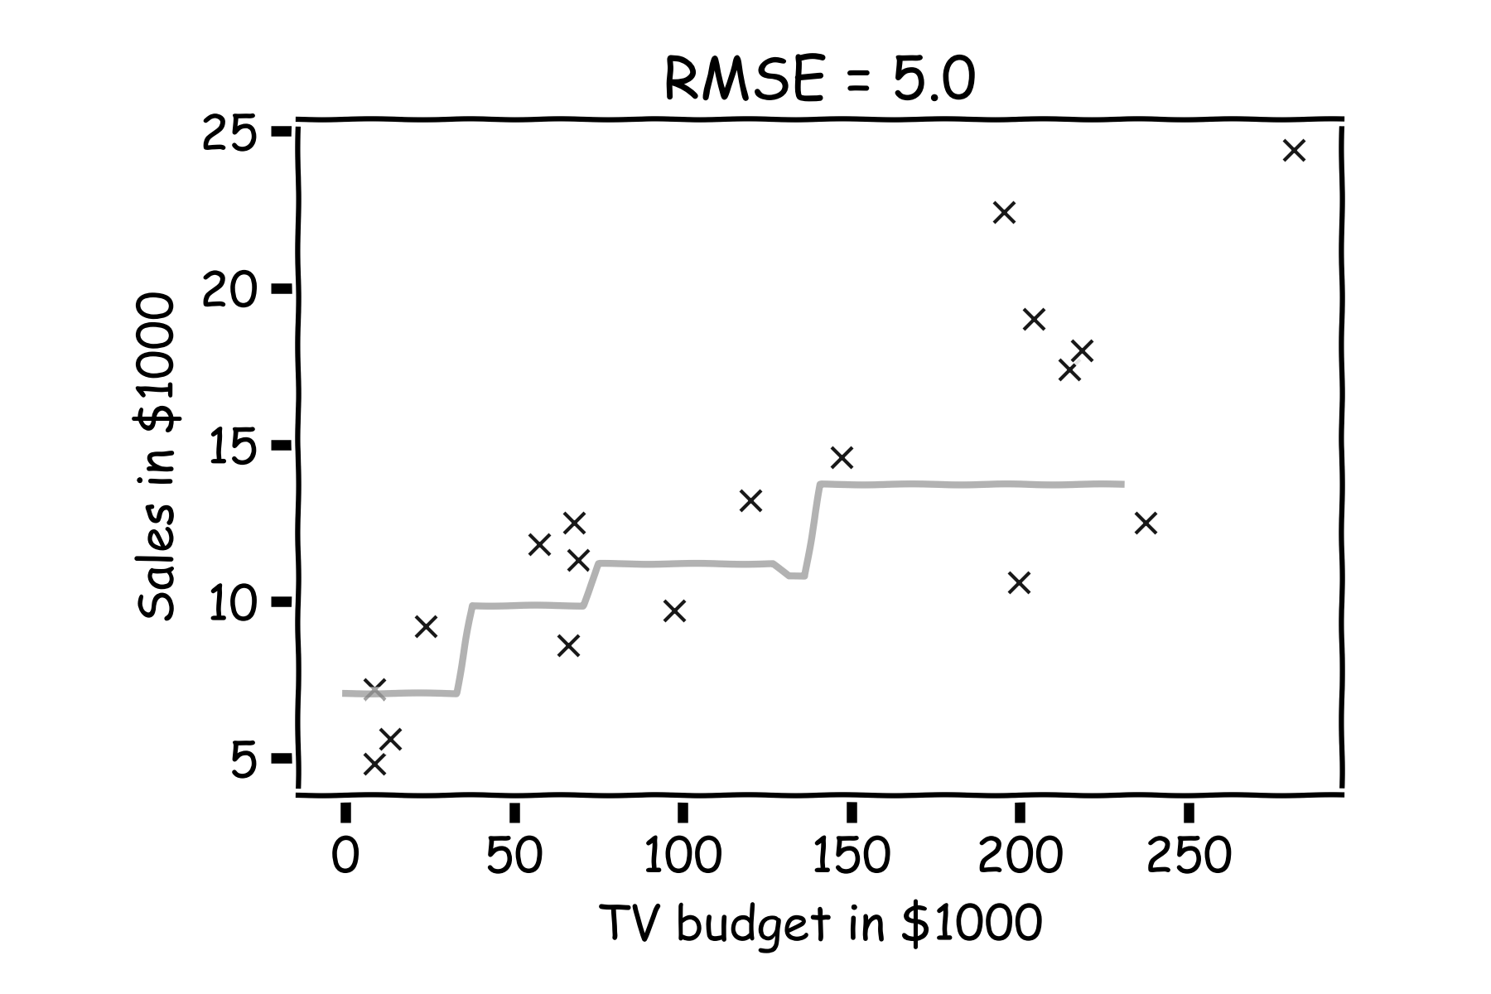
Model fitness
For a subset of the data, calculate the RMSE for k=3. Is RMSE=5.0 good enough?

Slide 57
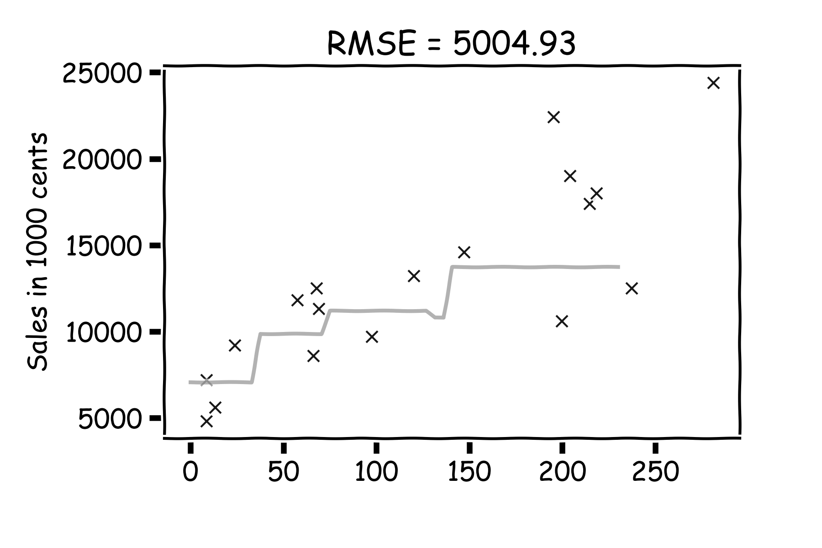
Model fitness
What if we measure the Sales in cents instead of dollars?
RMSE is now 5004.93.
Is that good?

Slide 58
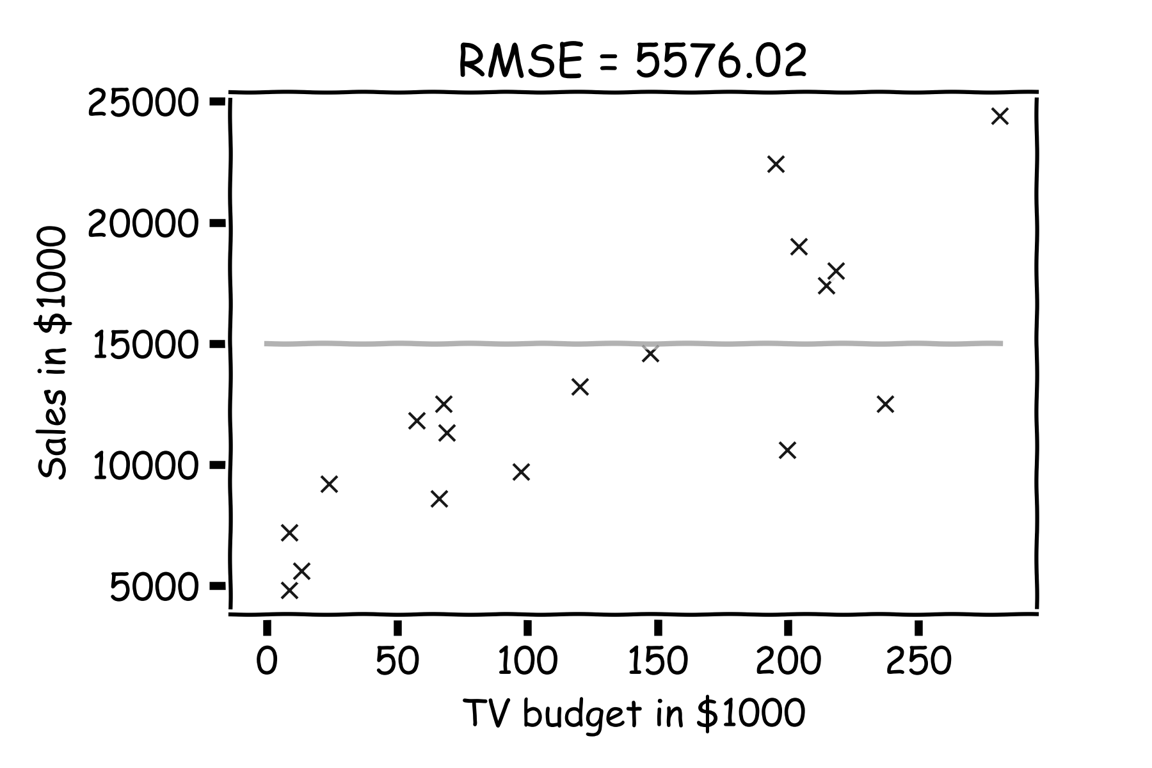
Model fitness
It is better if we compare it to something.
We will use the simplest model:
Notes:
Change this to a nicer plot
The subscript on the summation should be i=1 for clarity. I can’t seem to change this either… (DLS)

Slide 59
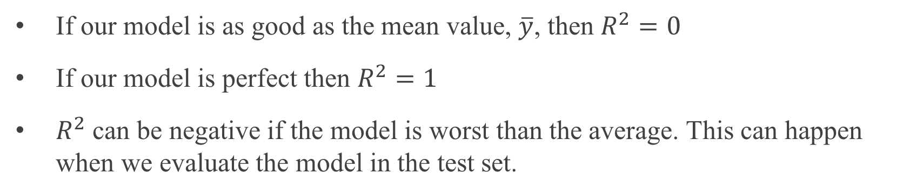
R-squared
If our model is as good as the mean value, $\overline{y}$, then $R^{2}=0$
If our model is perfect then $R^{2}=1$
$R^{2}$ can be negative if the model is worst than the average. This can happen when we evaluate the model in the test set.
Notes:
Change this to a nicer plot

Slide 60
Linear Regression

Slide 61
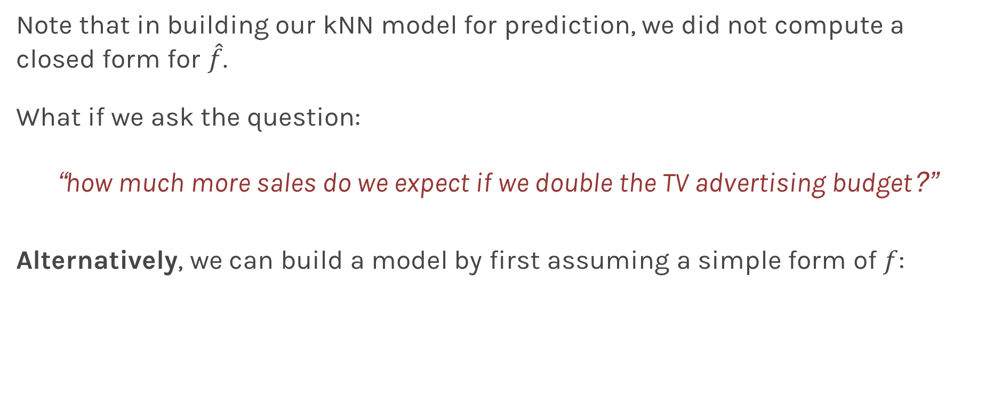
Linear Models
Note that in building our kNN model for prediction, we did not compute a closed form for $\hat{f}$.
What if we ask the question:
“how much more sales do we expect if we double the TV advertising budget?”
Alternatively, we can build a model by first assuming a simple form of $f$:

Slide 62
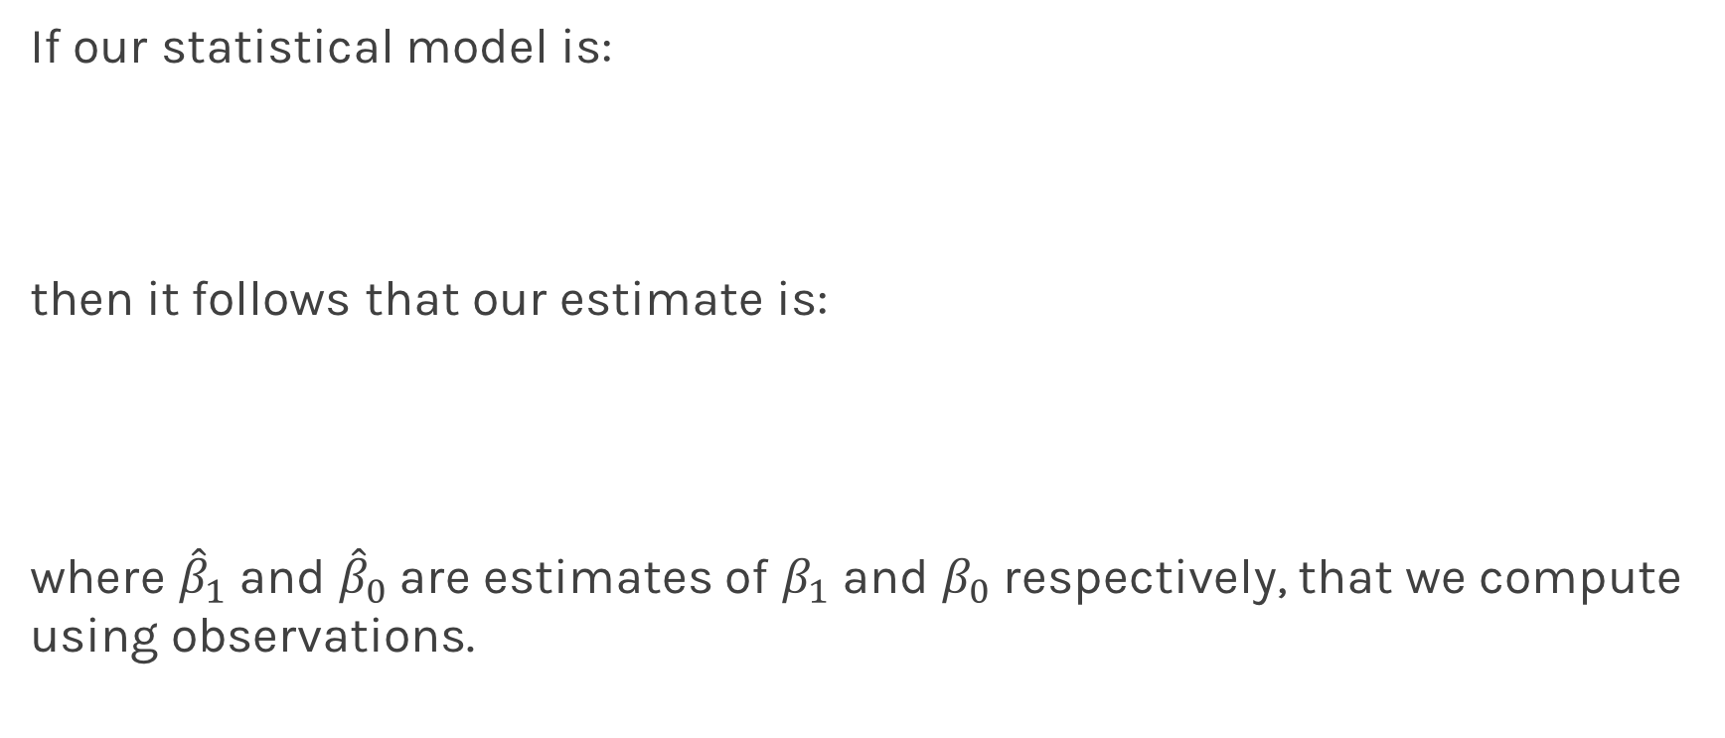
Linear Regression
If our statistical model is:
then it follows that our estimate is:
where ${\hat{β}}_{1}$ and ${\hat{β}}_{0}$are estimates of $β_{1}$ and $β_{0}$ respectively, that we compute using observations.

Slide 63
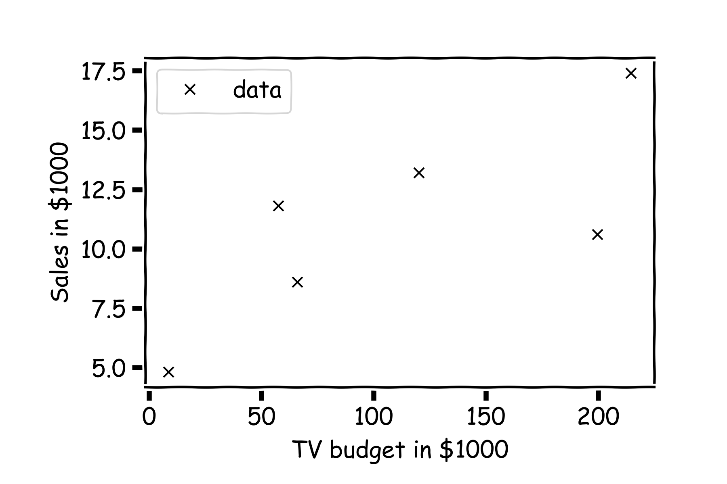
Linear Regression
For a given data set

Slide 64
Linear Regression
Is this line good?

Slide 65
Linear Regression
Maybe this one?

Slide 66
Linear Regression
Or this?

Slide 67
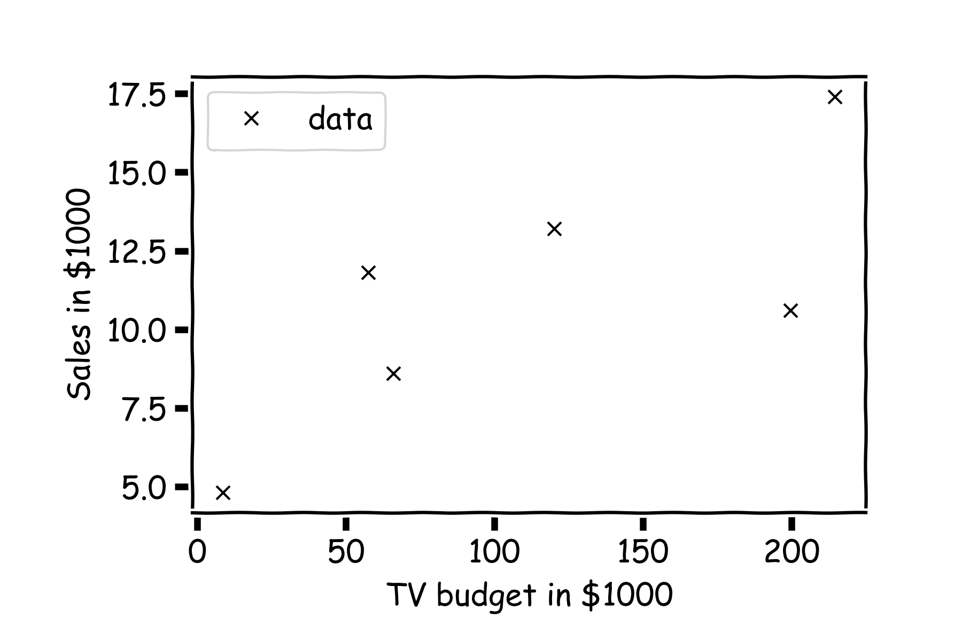
Inference for Linear Regression
First calculate the residuals

Slide 68
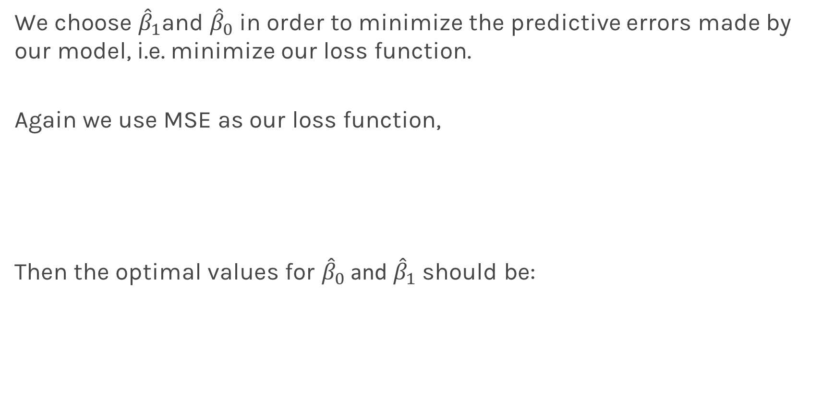
Inference for Linear Regression
We choose ${\hat{β}}_{1}$and ${\hat{β}}_{0}$ in order to minimize the predictive errors made by our model, i.e. minimize our loss function.
Again we use MSE as our loss function,
Then the optimal values for ${\hat{β}}_{0}$ and ${\hat{β}}_{1}$ should be:

Slide 69


Linear Regression
And calculate the loss function for every possible $β_{0}$ and $β_{1}$. Find the $β_{0}$ and $β_{1}$ where the loss function is minimum.
E.g. the loss function for different $β_{1}$ ($β_{0}$is fixed to be 6).
Notes:
Should you mention that this would be a ``numerical’’ approach? (DLS)

Slide 70

Alternatively:
Take the partial derivatives of $L$ with respect to $β_{0}$ and $β_{1}$, set to zero, and find the minimum. This procedure will give us explicit formulae for ${\hat{β}}_{0}$ and ${\hat{β}}_{1}:$
where $\overline{y}$ and $\overline{x}$are sample means.
The line:
is called the regression line.
Notes:
Should you mention that this is the analytical approach? (DLS)

Slide 71
Things to Consider
Comparison of Two Models
How do we choose from two different models?
Model Fitness
How does the model perform predicting?
Evaluating Significance of Predictors
Does the outcome depend on the predictors?
How well do we know $\hat{f}$
The confidence intervals of our $\hat{f}$

Slide 72
Evaluating Significance of Predictors

Slide 73

Interpretation of Predictors
Question: What do you think a predictor coefficient means?
$$Y=β_{0}+β_{1}x$$
$$Sales=7.5+0.04 TV$$
What does 7.5 mean and does 0.04 mean?
If we increase the TV by $1000, what would you expect the increase in sales to be? $40!!! Is it worth it?
What if
$$Sales=7.5+1.01 TV$$
Notes:
Axes labels! (DLS)

Slide 74


Evaluating Significance of Predictors
We interpret the $ε$term in our observation
to be noise introduced by random variations in natural systems or imprecisions of our scientific instruments.
If we knew the exact form of $f\left(x\right),$for example, $f\left(x\right)=β_{0}+β_{1}x$, and there was no $ε$ then estimating the ${\hat{β}}^{′}s$ would have been exact (so 1.01 is worth it?).
Notes:
Axes labels! (DLS)

Slide 75

Evaluating Significance of Predictors
However, three things happen:
we do not know the exact form of $f\left(x\right)$
$ε$ is always there
limited sample size
We first address $ε$
We call $ε$the measurement error or irreducible error. Since even predictions made with the actual function $f$ will not match observed values of $y$.
Because of $ε,$ every time we measure the response $Y$ for a fix value of $X$we will obtain a different observation, and hence a different estimate of ${\hat{β}}^{′}s.$

Slide 76

Evaluating Significance of Predictors
Start with a model

Slide 77

Evaluating Significance of Predictors
For a some values of $X,$ $Y=f(X)$

Slide 78

Evaluating Significance of Predictors
But due to error, every time we measure the response Y for a fixed value of X we will obtain a different observation.

Slide 79

Evaluating Significance of Predictors
One set of observations, “one realization” we obtain one set of Ys (red crosses).

Slide 80

Evaluating Significance of Predictors
Another set of observations, “another realization” we obtain another set of Ys (green crosses).

Slide 81

Evaluating Significance of Predictors
Another set of observations, “another realization” we obtain another set of Ys (black crosses).

Slide 82


Evaluating Significance of Predictors
For each one of those “realizations”, we could fit a model and estimate, ${\hat{β}}_{0}$ and ${\hat{β}}_{1}.$

Slide 83

Evaluating Significance of Predictors
For each one of those “realizations”, we could fit a model and estimate, ${\hat{β}}_{0}$ and ${\hat{β}}_{1}.$

Slide 84

Evaluating Significance of Predictors
For each one of those “realizations”, we could fit a model and estimate, ${\hat{β}}_{0}$ and ${\hat{β}}_{1}.$

Slide 85

Evaluating Significance of Predictors
So our estimates of ${\hat{β}}_{0}$ and ${\hat{β}}_{1}a$re just for one of those realizations.
Question: How do we deal with this problem?
Gabriel García Márquez, whose novel One Hundred Years of Solitude … magic realism.
Imagine we have parallel universes and we repeat this experiment on each of the other universes.

Slide 86

Evaluating Significance of Predictors
$$.$$
In our magical realism, we can now sample multiple times.

Slide 87

Evaluating Significance of Predictors
Another sample.

Slide 88

Evaluating Significance of Predictors
Another sample.

Slide 89

Evaluating Significance of Predictors
And another sample.

Slide 90

Evaluating Significance of Predictors
Repeat this for 100 times.

Slide 91

Evaluating Significance of Predictors
We can estimate the mean and standard deviation of all the estimates ${\hat{β}}_{1}$.

Slide 92


Evaluating Significance of Predictors
We can calculate the confidence intervals, which are the ranges of values such that the true value of $β_{1}$is contained in this interval with n percent probability.
95%
68%

Slide 93



Now we can answer the question, ’how significant are the predictors?’ Here we show the same analysis for all three predictors.
Question: Which ones are important?

Slide 94



Now we can answer the question, ’how significant are the predictors?’ Here we show the same analysis for all three predictors.
This is called hypothesis testing which we will visit again later next lecture.

Slide 95

Evaluating Significance of Predictors
However, three things happen:
we do not know the exact form of $f\left(x\right)$
$ε$ is always there
Sample size
We now address sample size
Sample estimates are approximation to population means.
Let’s think how this affects our estimate of predictors and how this affects are conclusions on the significance of the predictors.
Notes:
Aleatoric error? (DLS)

Slide 96
Sample size
Let’s re-examine this more carefully.
Notes:
[RD: ADD WHATEVER YOU WANT HERE ABOUT POPULATION VS SAMPLE]

Slide 97

Sample size
Let’s re-examine this more carefully.
In statistics, any estimate value is subject to sample size:
The estimated value, is called the sample mean
Whereas $E[x]$ is called the population mean
Notes:
[RD: ADD WHATEVER YOU WANT HERE ABOUT POPULATION VS SAMPLE]

Slide 98
Reality
In reality we do not have parallel universes. How did I do the histograms before?
I sub-sample from the true data and I pretended that this was my parallel universes.

Slide 99



TV | sales
230.1 | 22.1
44.5 | 10.4
17.2 | 9.3
151.5 | 18.5
180.8 | 12.9
8.7 | 7.2
57.5 | 11.8
120.2 | 13.2
8.6 | 4.8
199.8 | 10.6
66.1 | 8.6
214.7 | 17.4
23.8 | 9.2
97.5 | 9.7
204.1 | 19.0
195.4 | 22.4
67.8 | 12.5
281.4 | 24.4
69.2 | 11.3
147.3 | 14.6
Notes:
Here show how sub-sampling works ?

Slide 100



Sample size?
Bigger the sample less variation in the prediction

Slide 101

How do $μ_{β}$ and $σ_{β}$ depend on $ε, \hat{f}$, and number of samples?
Assume we know the functional form of $f,$we examine the relationship to number of samples.

Slide 102

How do $μ_{β}$ and $σ_{β}$ depend on $ε, \hat{f}$, and number of samples?
Notes:
Show the sub-sample size

Slide 103

How do $μ_{β}$ and $σ_{β}$ depend on $ε, \hat{f}$, and number of samples?
We used sub-sample size 50 before
Notes:
Show the sub-sample size

Slide 104

How do $μ_{β}$ and $σ_{β}$ depend on $ε, \hat{f}$, and number of samples?
However, we should have used sub-sample size 200.
Notes:
Show the sub-sample size

Slide 105
Bootstrap

Slide 106
Bootstrap
Imagine we have 5 billiard balls in a bucket.

Slide 107
Bootstrap
We first pick randomly a ball and replicate it. This is called sampling with replacement.
We move the replicated ball to another bucket.

Slide 108
Bootstrap

Slide 109
Bootstrap
We then pick randomly another ball and again we replicate it.
Again, we then move the replicated ball to the other bucket.

Slide 110
Bootstrap

Slide 111
Bootstrap
We repeat this process.
Notes:
Fix this with true replacement

Slide 112
Bootstrap
Again

Slide 113
Bootstrap
And again

Slide 114
Bootstrap
Until the other bucket has the same number of balls as the original one.

Slide 115
Bootstrap
We repeat the same process and acquire another sample

Slide 116
Bootstrap
We repeat the same process and acquire another sample

Slide 117

Bootstrapping for Estimating Sampling Error
Definition
Bootstrapping is the practice of estimating properties of an estimator by measuring those properties by, for example, sampling from the observed data.
For example, we can compute ${\hat{β}}_{0}$ and ${\hat{β}}_{1}$multiple times by randomly sampling from our data set. We then use the variance of our multiple estimates to approximate the true variance of ${\hat{β}}_{0}$ and ${\hat{β}}_{1}$.

Slide 118

Standard Errors
The variance of $β_{0}$ and $β_{1}$ are also called their standard errors, $SE\left({\hat{β}}_{0}\right),SE\left({\hat{β}}_{1}\right).$
If our data is drawn from a larger set of observations then we can empirically estimate the standard errors, $SE\left({\hat{β}}_{0}\right),SE\left({\hat{β}}_{1}\right)$ of $β_{0}$ and $β_{1}$through bootstrapping.
If we know the variance $σ^{2}$ of the noise $ε$, we can compute $SE\left({\hat{β}}_{0}\right),SE\left({\hat{β}}_{1}\right)$ analytically, using the formulae below:
Notes:
If data set is small this approximation does not work

Slide 119

Standard Errors
In practice, we do not know the theoretical value of $σ$ since we do not know the exact distribution of the noise $ε$. However, if we make the following assumptions,
the errors $ε_{i}=y_{i}−{\hat{y}}_{i}$and $ε_{j}=y_{j}−{\hat{y}}_{j}$ are uncorrelated, for $i≠j$ ,
each $ε_{i}$ is normally distributed with mean 0 and variance $σ^{2}$,
then, we can empirically estimate $σ^{2}$, from the data and our regression line:

Slide 120

Standard Errors
Exercise: Duplicate the following results for the coefficients for TV advertising.
Method | $$SE\left({\hat{β}}_{0}\right)$$ | $$SE\left({\hat{β}}_{1}\right)$$
Analytic Formula | 0.353 | 0.0023
Bootstrap | 0.328 | 0.0028

Slide 121

Importance of predictors
We have discussed finding the importance of predictors, by determining the cumulative distribution from $∞$ to 0.
.

Slide 122


Importance of predictors
This is equivalent in looking the distance of the estimated value of the coefficient in units of SE(${\hat{β}}_{1}$) = $σ_{{\hat{β}}_{1}}$.
.
$$μ_{{\hat{β}}_{1}}−0$$
$$σ_{{\hat{β}}_{1}}$$

Slide 123

Hypothesis Testing
Hypothesis testing is a formal process through which we evaluate the validity of a statistical hypothesis by considering evidence for or against the hypothesis gathered by random sampling of the data.
State the hypotheses, typically a null hypothesis, $H_{0}$ and an alternative hypothesis, $H_{1}$, that is the negation of the former.
Choose a type of analysis, i.e. how to use sample data to evaluate the null hypothesis. Typically this involves choosing a single test statistic.
Sample data and compute the test statistic.
Use the value of the test statistic to either reject or not reject the null hypothesis.

Slide 124
Hypothesis testing
1. State Hypothesis:
Null hypothesis:
$H_{0}$: There is no relation between X and Y
The alternative:
$H_{a}$: There is some relation between X and Y
2: Choose test statistics
To test the null hypothesis, we need to determine whether, our estimate for ${\hat{β}}_{1}$, is sufficiently far from zero that we can be confident that ${\hat{β}}_{1}$ is non-zero. We use the following test statistic:

Slide 125

Hypothesis testing
3. Sample:
Using bootstrap we can estimate ${\hat{β}}_{1}.$
4. Reject or not reject the hypothesis:
If there is really no relationship between X and Y , then we expect that will have a t-distribution with n-2 degrees of freedom.
To compute the probability of observing any value equal to $|t|$ or larger, assuming ${\hat{β}}_{1}=0$ is easy. We call this probability the p-value.
a small p-value indicates that it is unlikely to observe such a substantial association between the predictor and the response due to chance

Slide 126


Hypothesis testing
P-values for all three predictors done independently
Method | $$SE\left({\hat{β}}_{0}\right)$$ | $$SE\left({\hat{β}}_{1}\right)$$
Analytic Formula | 0.353 | 0.0023
Bootstrap | 0.328 | 0.0028
Method | $$SE\left({\hat{β}}_{0}\right)$$ | $$SE\left({\hat{β}}_{1}\right)$$
Analytic Formula | 0.353 | 0.0023
Bootstrap | 0.328 | 0.0028
Method | $$SE\left({\hat{β}}_{0}\right)$$ | $$SE\left({\hat{β}}_{1}\right)$$
Analytic Formula | 0.353 | 0.0023
Bootstrap | 0.328 | 0.0028

Slide 127
Things to Consider
Comparison of Two Models
How do we choose from two different models?
Model Fitness
How does the model perform predicting?
Evaluating Significance of Predictors
Does the outcome depend on the predictors?
How well do we know $\hat{f}$
The confidence intervals of our $\hat{f}$

Slide 128

How well do we know $\hat{f}$?
Our confidence in $f$ is directly connected with the confidence in $β$s. So for each $β$ we can make a prediction.

Slide 129

How well do we know $\hat{f}$?
Here we show two difference set of predictions given the fitted coefficients for a given subsample

Slide 130

How well do we know $\hat{f}$?
There is one such regression line for every imaginable sub-sample.

Slide 131


How well do we know $\hat{f}$?
Below we show all regression lines for a thousand of such sub-samples.
For a given $x$, we examine the distribution of $\hat{y}$, and determine the mean and standard deviation.

Slide 132

How well do we know $\hat{f}$?
For every $x$, we calculate the mean of the predictions, $\hat{y}$ (shown with dotted line) and the 95% CI of those predictions (shaded area).

Slide 133
What’s next?
So far we have examined only one predictor at the time. Next lecture we will see how to use multiple predictors together and evaluate the significance of each predictor when cofounding effects are present.
In this lecture we used sub-samples to estimate the CI. Next lecture we will introduce bootstrapping, a trick for re-using the data to estimate the CI.

Slide 134
Multiple Linear Regression

Slide 135
Response vs. Predictor Variables
X
predictors
features
covariates
Y
outcome
response variable
dependent variable
TV | radio | newspaper | sales
230.1 | 37.8 | 69.2 | 22.1
44.5 | 39.3 | 45.1 | 10.4
17.2 | 45.9 | 69.3 | 9.3
151.5 | 41.3 | 58.5 | 18.5
180.8 | 10.8 | 58.4 | 12.9
n observations
p predictors

Slide 136

Multilinear Models
In practice, it is unlikely that any response variable Y depends solely on one predictor x. Rather, we expect that is a function of multiple predictors $f(X_{1},…,X_{J})$. Using the notation we introduced last lecture,
$Y=y_{1},…,y_{n}$, $X=X_{1},…,X_{J}$and$X_{j}=x_{1j},…,x_{ij},…,x_{nj}$
In this case, we can still assume a simple form for $f$-a multilinear form:
Hence, $\hat{f}$, has the form
Notes:
We need a figure here

Slide 137

Multiple Linear Regression
Again, to fit this model means to compute ${\hat{β}}_{0},…,{\hat{β}}_{J}$we minimize a loss function; we will again choose the MSE as our loss function.
Given a set of observations,
the data and the model can be expressed in vector notation,
Notes:
We need a figure here

Slide 138
Multiple Linear Regression
The model takes a simple algebraic form:
Thus, the MSE can be expressed in vector notation as
Minimizing the MSE using vector calculus yields,
Notes:
We need a figure here

Slide 139

Finding Significant Predictors: Hypothesis Testing
For checking the significance of linear regression coefficients:
we set up our hypotheses $H_{0}$:
we choose the F-stat to evaluate the null hypothesis,

Slide 140

Finding Significant Predictors: Hypothesis Testing
we can compute the F-stat for linear regression models by
If $F=1$ we consider this evidence for $H_{0}$; if $F>1$, we consider this evidence against $H_{0}$.

Slide 141
Qualitative Predictors
So far, we have assumed that all variables are quantitative. But in practice, often some predictors are qualitative.
Example: The Credit data set contains information about balance, age, cards, education, income, limit , and rating for a number of potential customers.
Income | Limit | Rating | Cards | Age | Education | Gender | Student | Married | Ethnicity | Balance
14.890 | 3606 | 283 | 2 | 34 | 11 | Male | No | Yes | Caucasian | 333
106.02 | 6645 | 483 | 3 | 82 | 15 | Female | Yes | Yes | Asian | 903
104.59 | 7075 | 514 | 4 | 71 | 11 | Male | No | No | Asian | 580
148.92 | 9504 | 681 | 3 | 36 | 11 | Female | No | No | Asian | 964
55.882 | 4897 | 357 | 2 | 68 | 16 | Male | No | Yes | Caucasian | 331

Slide 142
Qualitative Predictors
If the predictor takes only two values, then we create an indicator or dummy variable that takes on two possible numerical values.
For example for the gender, we create a new variable:
We then use this variable as a predictor in the regression equation.

Slide 143
Qualitative Predictors
Question: What is interpretation of $β_{0}$ and $β_{1}$?

Slide 144

Qualitative Predictors
Question: What is interpretation of $β_{0}$ and $β_{1}$?
$β_{0}$ is the average credit card balance among males,
$β_{0}+β_{1}$ is the average credit card balance among females,
and $β_{1}$ the average difference in credit card balance between females and males.
Exercise: Calculate $β_{0}$ and $β_{1}$ for the Credit data.
You should find $β_{0}\sim \$509,β_{1}\sim \$19$

Slide 145
More than two levels: One hot encoding
Often, the qualitative predictor takes more than two values (e.g. ethnicity in the credit data).
In this situation, a single dummy variable cannot represent all possible values.
We create additional dummy variable as:

Slide 146
More than two levels: One hot encoding
We then use these variables as predictors, the regression equation becomes:
Again the interpretation
Notes:
[ADD interpretation and ONE HOT ENCODING]

Slide 147

Beyond linearity
In the Advertising data, we assumed that the effect on sales of increasing one advertising medium is independent of the amount spent on the other media.
If we assume linear model then the average effect on sales of a one-unit increase in TV is always $β_{1}$, regardless of the amount spent on radio.
Synergy effect or interaction effect states that when an increase on the radio budget affects the effectiveness of the TV spending on sales.

Slide 148
Beyond linearity
We change
To

Slide 149

What does it mean?

Slide 150
Predictors predictors predictors
We have a lot predictors!
Is it a problem?
Yes: Computational Cost
Yes: Overfitting
Wait there is more …

Slide 151
Polynomial Regression

Slide 152

Polynomial Regression
The simplest non-linear model we can consider, for a response Y and a predictor X, is a polynomial model of degree M,
Just as in the case of linear regression with cross terms, polynomial regression is a special case of linear regression - we treat each $x^{m}$ as a separate predictor. Thus, we can write

Slide 153
Polynomial Regression
Again, minimizing the MSE using vector calculus yields,

Slide 154
What’s Next
Overfitting
Applications of Model Selection
Behind Ordinary Lease Squares, AIC, BIC
Bias vs Variance
Regularization: LASSO and Ridge
Regularization Methods: A Comparison

Slide 155
Overfitting
Finding subsets of significant predictors is an important for model interpretation. But there is another strong reason to model using the smaller set of significant predictors: to avoid overfitting.
Question: What is overfitting?

Slide 156

Overfitting

Slide 157

Overfitting

Slide 158

Overfitting

Slide 159

Overfitting

Slide 160

Overfitting

Slide 161

Overfitting

Slide 162
Overfitting
Definition
Overfitting is the phenomenon where the model is unnecessarily complex, in the sense that portions of the model captures the random noise in the observation, rather than the relationship between predictor(s) and
response. Overfitting causes the model to lose predictive power on
new data.
Overfitting causes the model to lose predictive power on new data.

Slide 163

Causes of Overfitting
Overfitting can happen when:
there are too many predictors:
the feature space has high dimensionality
the polynomial degree is too high
too many cross terms are considered
the coefficients values are too extreme
A sign of overfitting may be a high training $R^{2}$or low MSE and unexpectedly poor testing performance.
Note: There is no 100% accurate test for overfitting and there is not a 100% effective way to prevent it. Rather, we may use multiple techniques in combination to prevent overfitting and various methods to detect it.

Slide 164
Model Selection
Model selection is the application of a principled method to determine the complexity of the model, e.g. choosing a subset of predictors, choosing the degree of the polynomial model etc.
Model selection typically consists of the following steps:
split the training set into two subsets: training and validation
multiple models (e.g. polynomial models with different degrees) are fitted on the training set; each model is evaluated on the validation set
the model with the best validation performance is selected
the selected model is evaluated one last time on the testing set

Slide 165
Model Comparison
Do the same for all k’s and compare the RMSEs. k=3 seems to be the best model.

Slide 166

Cross Validation

Slide 167

Variable Selection Computational Complexity
Question: How many models do we need to evaluate?
1 predictor: $J$
2 predictors: $J choose 2 ⟹ \frac{J!}{2!\left(J−2\right)!}$
k predictors: $J choose k⟹\frac{J!}{k!\left(J−k\right)!}$
…
J predictors: $J choose J⟹\frac{J!}{k!\left(J−k\right)!}=1$
Total: $2^{J}$

Slide 168
Stepwise Variable Selection and Cross Validation
Selecting optimal subsets of predictors (including choosing the degree of polynomial models) through:
stepwise variable selection - iteratively building an optimal subset of predictors by optimizing a fixed model evaluation metric each time,
validation - selecting an optimal model by evaluating each model on validation set.
We will also address the issue of discouraging extreme values in model parameters later.

Slide 169

Stepwise Variable Selection: Forward method
In forward selection, we find an ‘optimal’ set of predictors by iterative building up our set.
1. Start with the empty set P0, construct the null modelM0.
2. For $k=1,…, J:$
2.1 Let $M_{k−1}$ be the model constructed from the best set of
$k−1$ predictors, $P_{k−1}$.
2.2 Select the predictor ${X_{n}}_{k}$, not in $P_{k−1}$, so that the model constructed from $P_{k}=$ ${X_{n}}_{k}∪P_{k−1}$ optimizes a fixed metric (this can be p -value, F -stat; validation MSE, $R^{2}$, or AIC/BIC on training set).
2.3 Let $M_{k}$ denote the model constructed from the optimal $P_{k}$.
3. Select the model $M$ amongst $\{M_{0}, M_{1},…, M_{J}\}$that optimizes a fixed metric (this can be validation MSE, $R^{2};$or AIC/BIS on training sey)

Slide 170
Stepwise Variable Selection Computational Complexity
How many models did we evaluate?
1st step, J Models
2nd step, J-1 Models (add 1 predictor out of J-1 possible)
3rd step, J-2 Models (add 1 predictor out of J-2 possible)
…

Slide 171
Cross Validation

Slide 172

Cross Validation Motivation

Slide 173

Cross Validation

Slide 174

Cross Validation

Slide 175
Cross Validation

Slide 176
Cross Validation
Using a single validation set to select amongst multiple models can be problematic - there is the possibility of overfitting to the validation set.
One solution to the problems raised by using a single validation set is to evaluate each model multiple validation sets and average the validation performance.
One can randomly split the training set into training and validation multiple times, but randomly creating these sets can create the scenario where important features of the data never appear in our random draws.

Slide 177

Leave-One-Out
Given a data set $\left\{X_{1},…,X_{n}\right\}$ where each $X_{1}=\left(x_{i1},…,x_{ij}\right)$ contains $J$ number of features.
To ensure that every observation in the dataset is included in at least one training set and at least one validation set, we create training/validation splits using the leave one out:
validation set: $X_{i}$
training set: $\left\{X_{1},…,X_{i−1},X_{i+1},…,X_{n}\right\}$
We fit the model on each training set, denoted ${\hat{f}}_{X_{−i}}$and evaluate it on the corresponding validation set, ${\hat{f}}_{X_{−i}}(X_{i}$)
The cross validation score is the performance of the model averaged across all validation
where L is a loss function.

Slide 178

K-Fold Cross Validation
Rather than creating n number of training/validation splits, each time leaving one data point for the validation set, we can include more data in the validation set using k-fold validation:
split the data into K uniformly sized chunks, $\left\{C_{1},…, C_{k}\right\}$
we create K number of training/validation splits, using one of the K chunks for validation and the rest for training.

Slide 179

K-Fold Cross Validation
We fit the model on each training set, denoted ${\hat{f}}_{C_{−i}}$, and evaluate it on the corresponding validation set, ${\hat{f}}_{C_{−i}}(X_{i}$) . The cross validation score is the performance of the model averaged across all validation sets:

Slide 180
Predictor Selection: Cross Validation
Rather than choosing a subset of significant predictors using stepwise selection with train/validation method, we can use K-fold cross validation:
create a collection of different subsets of the predictors for each subset of predictors, compute the cross
validation score for the model created using only that subset
select the subset (and the corresponding model) with the best cross validation score
evaluate the model one last time on the test set
Question: What is the difference in multiple predictors and polynomial regression in model selection?

Slide 181
Predictor Selection: Cross Validation
We can frame the problem of degree selection for polynomial models as a predictor selection problem: which of the predictors
should we select for modeling?
We can apply stepwise selection to determine the optimal subset of predictors.

Slide 182
Degree Selection: Cross Validation
We can also select the degree of a polynomial model using K-fold cross validation sequentially.
consider a number of different degrees for each degree, compute the cross validation score for a polynomial model of that degree
select the degree, and the corresponding model with the best cross validation score
evaluate the model one last time on the test set.

Slide 183
kNN Revisited

Slide 184
kNN Revisited
Recall our first simple, intuitive, non-parametric model for regression - the kNN model. We saw that it is vitally important to select an appropriate k for the data.
If the k is too small then the model is very sensitive to noise (since a new prediction is based on very few observed neighbors), and if the k is too large, the model tends towards making constant predictions.
A principled way to choose k is through K-fold cross validation.

Slide 185
Without CV
In many scenarios, data are not abundant and therefor CV may not be feasible.
What if we do not have enough data to do CV?

Slide 186
Behind Ordinary Lease Squares, AIC, BIC

Slide 187
AIC and BIC
We’ve mentioned using AIC/BIC to evaluate the explanatory powers of models. The following formulae can be used to calculate these criteria:
where J is the number of predictors in model.
Intuitively, AIC/BIC is a loss function that depends both on the predictive error, RSS, and the complexity of the model. We see that we prefer a model with few parameters and low RSS.
But why do the formulae look this way - what is the justification?

Slide 188
Back to MSE

Slide 189

Likelihood Functions
Recall that our statistical model for linear regression in matrix notation is:
It is standard to suppose that $ε\sim N\left(0,σ^{2}\right).$In fact, in many analyses we have been making this assumption. Then,
Question: Can you see why?
Note that $N\left(xβ,σ^{2}\right)$ is naturally a function of the model parameters $β$, since the data is fixed.

Slide 190

Likelihood Functions
We call:
the likelihood function, as it gives the likelihood of the observed data for a chosen model $β$.

Slide 191

Maximum Likelihood Estimators
Once we have a likelihood function, $ℒ(β)$, we have strong incentive to seek values of to maximize $ℒ$.
Can you see why?
The model parameters that maximizes $ℒ$ are called maximum likelihood estimators (MLE) and are denoted:
The model constructed with MLE parameters assigns the highest likelihood to the observed data.

Slide 192

Maximum Likelihood Estimators
But how does one maximize a likelihood function?
Fix a set of n observations of J predictors, X, and a set of corresponding response values, Y; consider a linear model $Y=Xβ+ε$.
If we assume that $ε∼Ν(0,σ^{2})$ then the likelihood for each observation is
and the likelihood for the entire set of data is

Slide 193

Maximum Likelihood Estimators
Through some algebra, we can show that maximizing $ℒ(β)$, is equivalent to minimizing MSE:
Minimizing MSE or RSS is called ordinary least squares.

Slide 194

Information Criteria Revisited
Using the likelihood function, we can reformulate the information criteria metrics for model fitness in very intuitive terms.
For both AIC and BIC, we consider the likelihood of the data under the MLE model against the number of explanatory variables used in the model:
where g is a function of the number of predictors J. Individually,
In the formulae we’d been using for AIC/BIC, we approximate $ℒ(β)$, using the MSE.

Slide 195
Bias vs Variance

Slide 198
Bias vs Variance
Left: 200 best fit straight lines, each a fit on a different 30 point training sets from a 200 point population.
Right: Best-fit models using degree 20 polynomial

Slide 199
Bias vs Variance
Left: Linear regression coefficients
Right: Poly regression of order 20 coefficients

Slide 200
Variance

Slide 201

Variance

Slide 202
Regularization: LASSO and Ridge

Slide 203

Regularization: An Overview
The idea of regularization revolves around modifying the loss function L; in particular, we add a regularization term that penalizes some specified properties of the model parameters
where $λ$ is a scalar that gives the weight (or importance) of the regularization term.
Fitting the model using the modified loss function L_{reg} would result in model parameters with desirable properties (specified by R).

Slide 204
LASSO Regression
Since we wish to discourage extreme values in model parameter, we need to choose a regularization term that penalizes parameter magnitudes. For our loss function, we will again use MSE.
Together our regularized loss function is:
Note that is the l₁ norm of the vector β

Slide 205

LASSO Regression
Hence, we often say that L_{LASSO} is the loss function for l₁ regularization.
Finding the model parameters β_{LASSO} that minimize the l₁ regularized loss function is called LASSO regression.

Slide 206
Ridge Regression
Alternatively, we can choose a regularization term that penalizes the squares of the parameter magnitudes. Then, our regularized loss function is:
Note that is the l₂ norm of the vector β

Slide 207

Ridge Regression
Hence, we often say that L_{ridge} is the loss function for l₂ regularization.
Finding the model parameters β_{ridge} that minimize the l₂ regularized loss function is called ridge regression.

Slide 208
Choosing λ
In both ridge and LASSO regression, we see that the larger our choice of the regularization parameter λ, the more heavily we penalize large values in β,
If λ is close to zero, we recover the MSE, i.e. ridge and LASSO regression is just ordinary regression.
If λ is sufficiently large, the MSE term in the regularized loss function will be insignificant and the regularization term will force β_{ridge} and β_{LASSO} to be close to zero.
To avoid ad-hoc choices, we should select λ using cross-validation.

Slide 209
Ridge - Computational complexity
Solution to ridge regression:
The solution of the Ridge/Lasso regression involves three steps
Select λ
Find the minimum of the ridge/Lasso regression cost function (using linear algebra) as with the multiple regression and record the R² on the test set.
Find the λ that gives the largest R²

Slide 210
The Geometry of Regularization

Slide 211
Variable Selection as Regularization
Since LASSO regression tend to produce zero estimates for a number of model parameters - we say that LASSO solutions are sparse - we consider LASSO to be a method for variable selection.
Many prefer using LASSO for variable selection (as well as for suppressing extreme parameter values) rather than stepwise selection, as LASSO avoids the statistic problems that arises in stepwise selection.
Question: What are the pros and cons of the two approaches?

